Slide 1
Blueprint for a Co-operative Decade International Co-operative Alliance Asia & Pacific Regional Assembly Bali, Indonesia
Charles Gould
Director-General
19 September 2014

Slide 2
Co-operatives are a proven
self-help model in good and
bad times
Co-operatives are a successful
movement for today, developing
a sustainable economy, social
equity, and democracy

Slide 3
Blueprint for a Co-operative Decade

Slide 4
Co-operatives put people first
and use their profits to serve
the needs of people
Economies with a greater
diversity of business models
are more stable: co-operatives
add business diversity

Slide 5
Blueprint Pillars
Differentiators
Participation
Sustainability
Identity
Inhibitors / Facilitators
Legal Frameworks
Capital
Identity
Participation

Slide 6
Co-operatives are highly
sustainable businesses, combining
financial health, environmental
Concern, and social purpose
in a triple bottom line
As people-centred businesses,
co-operatives will be the preferred
model of business by 2020

Slide 7

Thought Leadership Paper on Co-operative Growth

Slide 8

Thought Leadership Paper on Co-operative Growth

Slide 9

World Co-operative Monitor

Slide 10
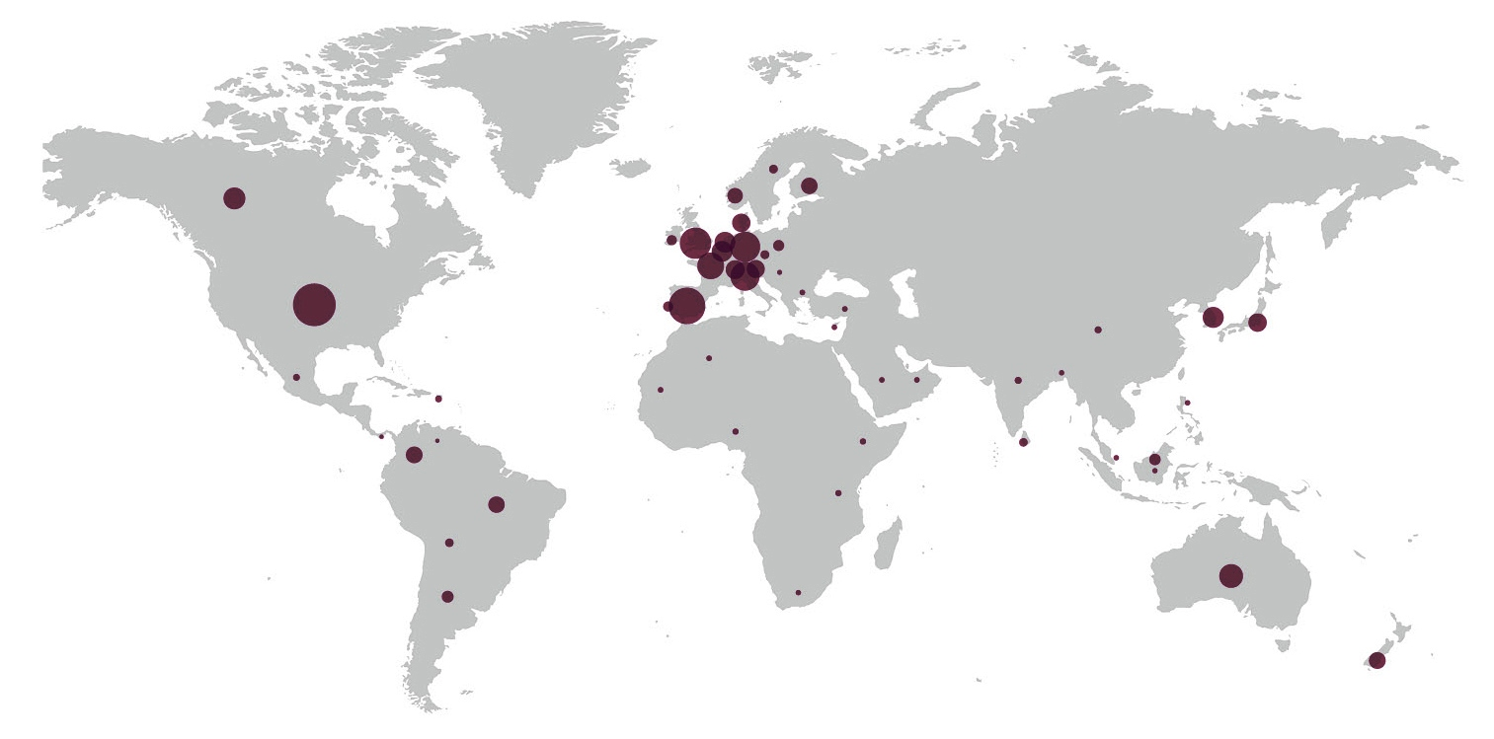
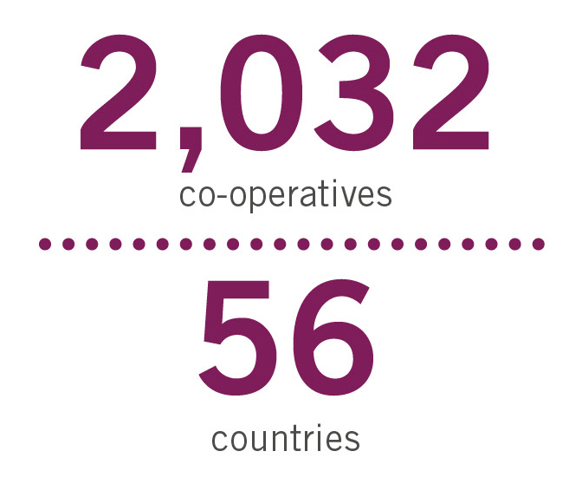
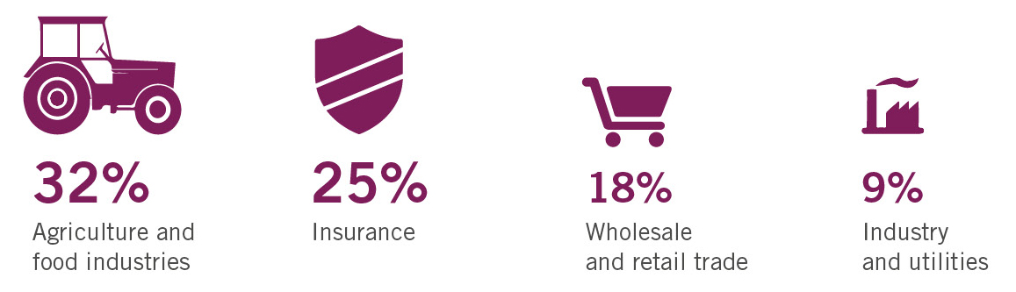
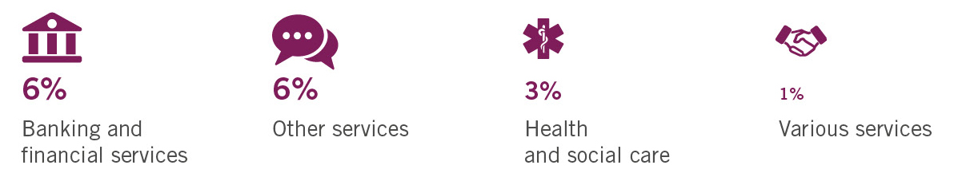
The Database

Slide 11
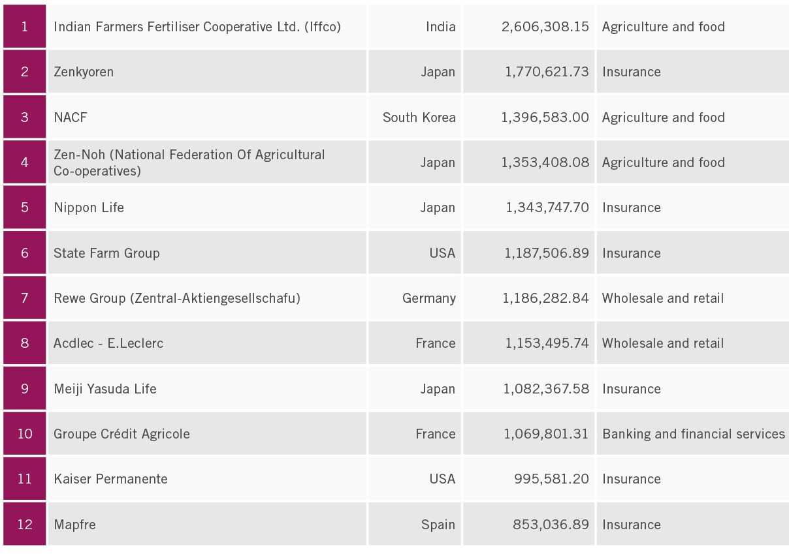
World Co-operative Monitor

Slide 12
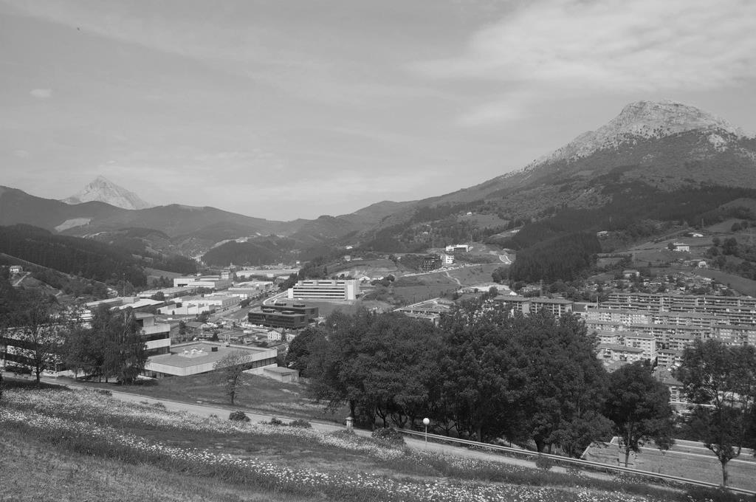

“
The co-operative sector needs to demonstrate convincingly that sustainability is in the intrinsic nature of co-operatives.
– Blueprint for a Co-operative Decade
”
www.ssg.coop

Slide 13


Sustainability Scan

Slide 14


Slide 15

United Nations International Year of Co-operatives

Slide 16

Investigation of co-operative visual language around the world

Slide 17

The Marque

Slide 18
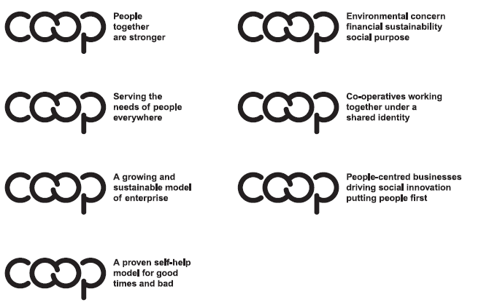
Key messages

Slide 19
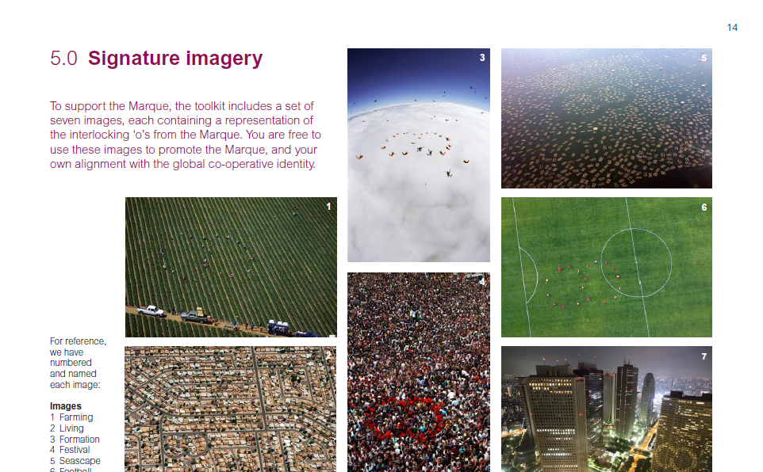
Signature images

Slide 20

Co-operative Identity
www.identity.coop

Slide 21

Guidance Notes

Slide 22
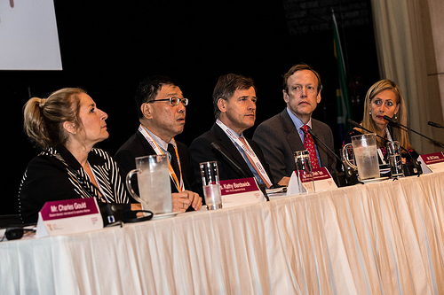
Blue Ribbon Commission on Co-operative Capital

Slide 23
Capital
Co-operatives need access
to adequate capital in order to reach their full potential

Slide 24
Legal Framework — Doing Co-operative Business
Co-operatives need full
promotion of their unique
business model through
appropriate legislation and
public policy in order to thrive

Slide 25




Global policy

Slide 26
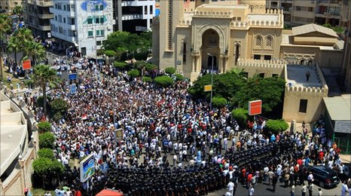


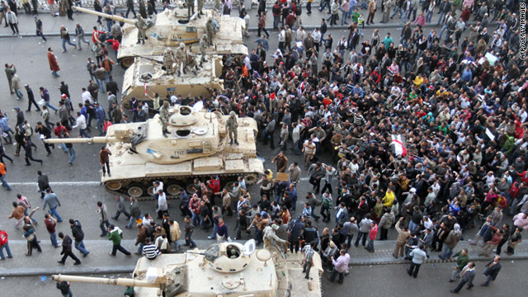
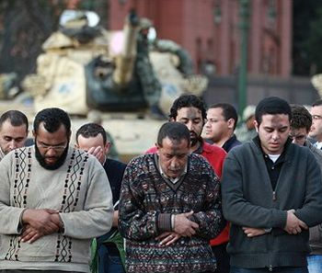

Slide 27
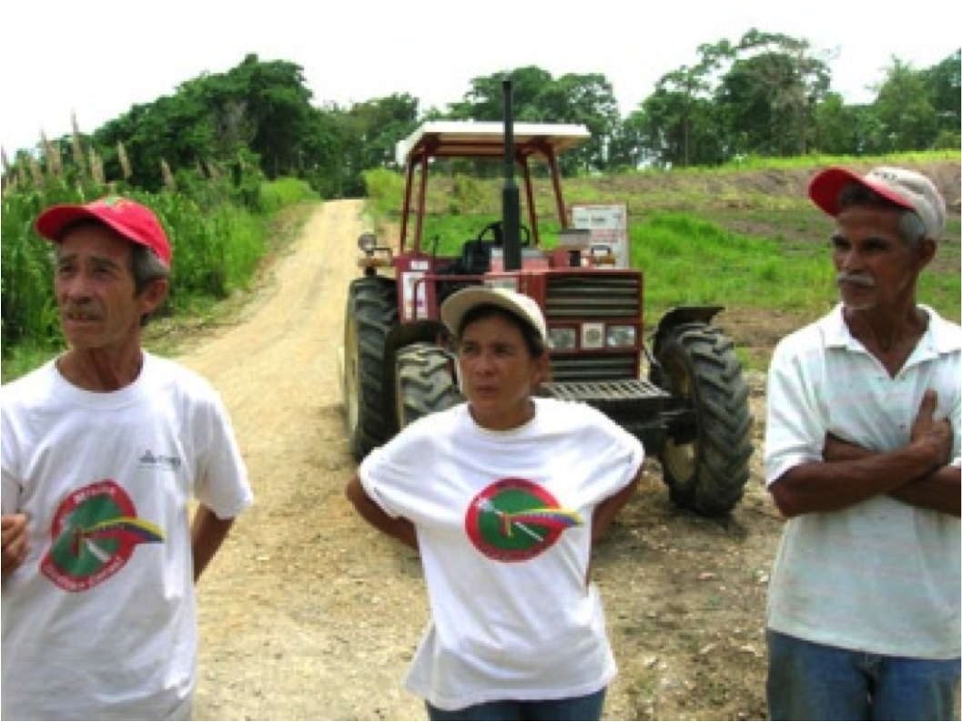

Slide 28
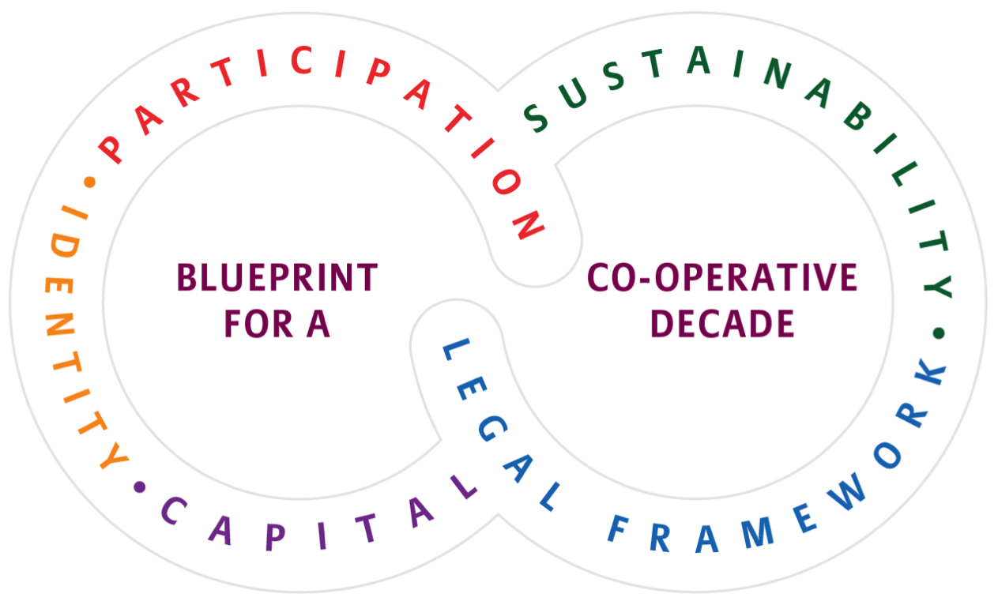
Co-operative Roundtable

Slide 29
Charles Gould gould@ica.coop

