Slide 1

CAMPUS COOPERATIVES & EDUCATING YOUTH ABOUT COOPERATIVES
DR. DINESH
CHIEF EXECUTIVE
National Cooperative Union of India ( NCUI)

Slide 2
CAMPUS COOPS IN INDIA
Originally started during the Freedom Movement
First campus coop, with students, teachers and staff as members, started in Punjab in 1917
Later spread to South India
At present around 10,000 coops including schools, colleges and universities

Slide 3
Present Coverage
1. Mostly concentrated in South – around 3000 each in Kerala and Tamil Nadu and 300 each in Karnataka, Andhra Pradesh and Maharashtra
2. Most coops are in high schools
3. Most of them registered either as Consumer Coop or Multi Purpose Coop
4. Also presence of Credit Coops – but only staff and faculty as members

Slide 4
Successful Examples of Campus Cooperatives in India
Mangalore University Cooperative Society Ltd.
Business include: Books, Stationery, Credit, Textile, PDS, Milk Supply, Floor Mill and supply of stationery and books to university
Financial Performance: 2011-12
Turnover: INR 92,080,680
Net Profit: INR 1,966,458
Dividend: 21 Percent

Slide 5
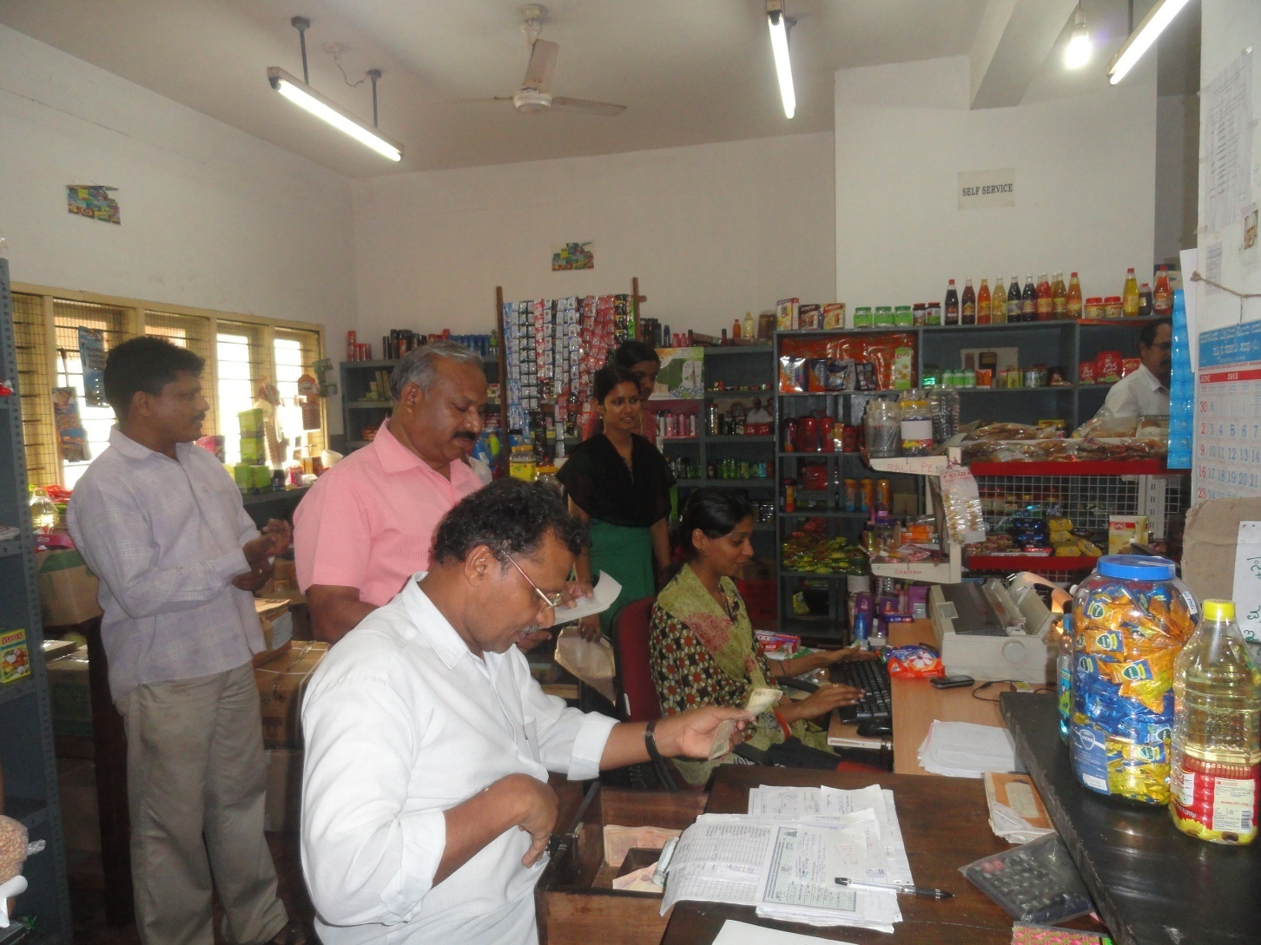
MANGALORE UNIVERSITY COOPERATIVE Consumer’s STORE

Slide 6
Salient Features of Campus Cooperatives in India
Statutory provisions in all States for students to become members and also Board Members – though different systems of selection are followed
Main business is dealing in stationery and text books – but in some cases providing canteen service, transportation service etc
Teachers generally play a major role in running these coops

Slide 7
Strength
Increased Awareness
Full Membership to Students
Diversified business activities
Training programs by NCCT
Support by NCUI
Financial support by NCDC
Regular National Seminars
No Government intervention
Youth and Social activities by some Coops
Efforts for inclusion in curriculum

Slide 8
Weakness
Declining Number
Regional Imbalance
Inadequate support by University/College Management
Too much dependence on Faculty Members
Small size and problem of viability
Lack of focus on business development
Legal hurdles for creating a Federation

Slide 9
CAUSES FOR RETARDED GROWTH
NCUI Study Identified the Following Constraints:
Lack of Adequate Finance
Irregular Supplies
Participation of the Students in the working and management of the Stores is lacking
No Separate Cell in the State Cooperative Department to Monitor the Progress and Promotion of Students Cooperatives

Slide 10
FACILITATING ENVIRONMENT
The legal system in India is very liberal and allows student members in campus coops.
At school level students are nominal members and at college and university level they are full members with participation as Board members
Generally campus coops in India deal with books and student stationery, with small sized shops but some university cooperatives are big and offer multiple services

Slide 11
NCUI COOP-CONNECT PROJECT INITIATIVES
STARTED IN 2009 BY NCUI TO ATTRACT YOUTH TOWARDS COOPERATIVE MOVEMENT
MANY PROGRAMMES FOR SCHOOLS WITH STUDENTS VISITING NCUI
STUDENTS AND TEACHERS MOVITATED TO UNDERSTAND, APPRECIATE AND SUPPORT COOPERATIVES

Slide 12
NCUI initiatives at international level
National Cooperative Union of India in collaboration with ICA, KSCF Bangalore and University of Mangalore organised the SAARC Regional Workshop at Mangalore in March 2011. The Participants were from India, Srilanka, Bhutan, Japan, Malaysia, Indonesia, Iran, Uganda and Afghanistan.
NCUI will closely work with ICA Committee on University/Campus Cooperatives in all its activities.

Slide 13
NCUI initiatives in other States : KERALA
As part of International Year of Cooperatives, to promote University Cooperative in Universities, In-stitute organized a one day sensitization Programme on “Formation of Cooperative in College Campus for Faculty and Students of various colleges on 21st March 2013” under the sponsorship of NCUI. A to-tal of 24 participants, comprising of 5 Faculty Members and 19 Students from 4 Colleges participated in the programme. The nature, working and role of cooperatives were elaborately discussed, besides the formalities involved in organizing a cooperative society in the college campus

Slide 14
NCUI initiatives in other States : MAHARASTRA
NCUI through the Vaikunt Mehtha National Institute for Cooperative Management, Pune conducted a one day workshop on Campus Cooperatives, at North Maharastra University, Jalgaon on 16th March 2013

Slide 15
NCUI’s Initiatives in Schools

Slide 16
Quiz and Debate Competition for School Children to create awareness
NCUI regularly organizing Inter School Quiz Competition on Cooperatives at the occasion of All India Cooperative Week Celebrations during 14 – 20 November every year, in which students of the top level schools in Delhi participated.
Organized inter school Debate Competition on Cooperatives for the first time in December 2010 where 10 schools of Delhi participated.

Slide 17
Cooperative Sensitization Programmes for School Students
During the sensitization progarmme, generally for two hours duration, students were acquainted with basic knowledge of cooperatives – its organization structure, principles & values and formation of cooperatives.
Target group for this programme is generally students of 10 to 12 standards from economics, commerce and social science streams.

Slide 18
Sensitization Workshop for Principal & School Teachers
A National Workshop for Principals & School Teachers in Delhi was organized during April 2012
Focus of the workshop was to sensitize the Principals & teachers so that they encourage the students to engage themselves in the activities related to cooperatives.

Slide 19
NCUI’s Initiatives in the UNIVERSITY

Slide 20
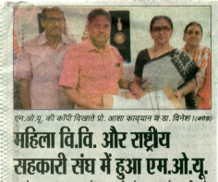
NCUI signed MOU with an Women University in Haryana State & launched a Certificate Programme in Cooperative Management

Slide 21
Objectives of one year Certificate of Proficiency Course in Cooperative Management
To enrich the girls students by:
to impart the basic knowledge about the origin, genesis, concept and importance of cooperative enterprises in the Indian Economy.
improving their conceptual capabilities in understanding the managerial problems of cooperatives;
upgrading their skills and abilities to use appropriate techniques for Managing Cooperatives; and
developing attitude appropriate for achieving excellence in cooperative management and Administration & cooperative business enterprise.

Slide 22
Objectives of one year Certificate of Proficiency Course in Cooperative Management
To develop girl student as change agents in Cooperatives who can:
Initiate/ launch, establish & run their own cooperative business enterprises keeping the local resources in view and motivate others

Slide 23
Semester I : Cooperative Concept and Management
Environment for Cooperative and Rural Development
Cooperative Management
Cooperative Credit, Banking & Non-credit cooperatives
Project Work on successful cooperative societies / organization
Important : After the completion of first Semester, the students would be sent for practical study visit / placement for two weeks to successful women cooperative organizations and the other types of cooperative enterprises

Slide 24
Semester II : Cooperative Finance and Micro Enterprises
Cooperative Accounts, Audit & MIS
Cooperative Project Planning, Formulation & Entrepreneurship Development
Cooperative Law
Role of Cooperatives in Agriculture & Rural Development

