Slide 1
Human Resource Is Key to Good Governance

Slide 2
If you don't know where you are going, you are certain to end up somewhere else.
- Yogi Berra

Slide 3
You need to define where do you really want to go?
“A viable and competitive community based
cooperative financial institution.”
Sustained Growth

Slide 4
Sustainable Credit Coop
Depositors
Leaders
Employees
Borrowers

Slide 5
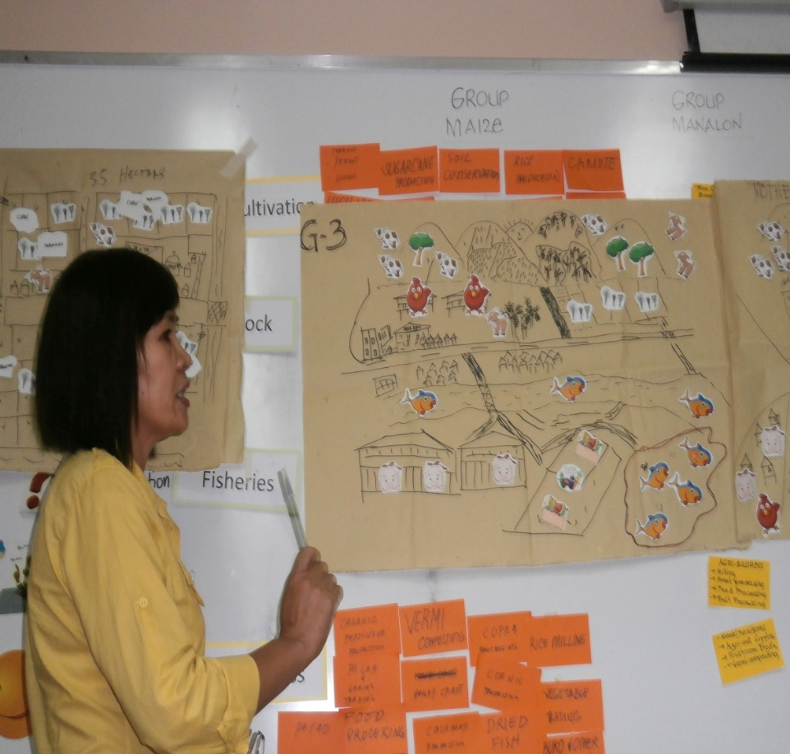
What are we really aiming for?
Key Success Indicators
  Financial Viability
  Operational Efficiency
  Competitive Position
  Member Satisfaction
  Employee Satisfaction

Slide 6
Concepts and Framework

Slide 7
What is Governance?
Benefits of Good Governance?

Slide 8
Cooperative Governance:
is a . . .
Process
Structure
Information
used for directing and overseeing the management of the cooperative

Slide 9
Cooperative Governance:
It encompasses the means by which members of the board of directors and senior management
are held accountable for their actions, and for the establishment and implementation of oversight functions and processes

Slide 10
Cooperative Governance:
Board of Directors
Only as a group can the BOD make decision ! ! !
GOVERNANCE
Work as a team.
Has a different role to play within the team.
With proper authority to act and make decisions.
Mutual confidence and trust are essential ingredients of the team.
C E O
(Manager)
S T A F F
MANAGEMENT

Slide 11

Benefits of Effective Governance
Improved Organizational PERFORMANCE

Slide 12

Benefits of Effective Governance
Promotes economic FINANCIAL STABILITY
and facilitates
GROWTH

Slide 13

Benefits of Effective Governance
More effective utilization of RESOURCES

Slide 14

Benefits of Effective Governance
Enhanced
CREDIBILITY for the organization – dependent
on trust relationship

Slide 15
Benefits of Effective Governance
Preferred
EMPLOYER and Preferred DIRECTORSHIPS
It’s not all about money but the prestige

Slide 16
Benefits of Effective Governance
Greater respect for
ORGANIZATIONAL BRAND
First choice for financial
services in our community!

Slide 17
What are the basis of credit
coop governance?

Slide 18
BASIS OF CREDIT COOP GOVERNANCE
EXTERNAL:
Legislation/Regulations pursuant to the Act (as applicable) RA 9520
Memo circulars
Sound business practices
Deposit Insurance/ Stabilization Fund (as applicable)

Slide 19
BASIS OF CREDIT COOP GOVERNANCE
INTERNAL:
Articles of Incorporation & Bylaws
Vision, Mission, Values
Board Policies
Strategic Plan
Annual Budget
Management Policies and Procedures

Slide 20
Credit Coop Act (Congress)
Regulations
(CDA, Agencies)
Sound Business
Practices (Industry)
Articles & By Laws (Assembly)
Credit Coop
Policies (BOD)
Credit Coop
Procedures
(Management)

Slide 21
ACCU Strategic Direction: SUSTAINABLE CREDIT UNION SYSTEM IN ASIA
 |  |  |  |  | CU Network Development
 |  |  |  | QUALITY ASSURANCE Branding, Benchmarking, Risk Based Supervision, Stabilization Fund, Credit Union Law, CRM
 |  |  | PROFESSIONALIZATION Systems development, policies, products & services, prudential standards, management training, Strategic Planning, Good Governance, HRM, market segmentation
 |  | LEADERSHIP DEVELOPMENT Formation of the National Federations (service organizations for credit union development) and training of leaders
MOTIVATION Credit Union Philosophy, principles and values (continuing in economies in transition)
1971 to 1980 | 1981 to 1992 |  | 1992 to 2005 | 2005 to 2014 | Beyond 2014
Managing growth & sustainability
Building Credit Union
Foundations

Slide 22
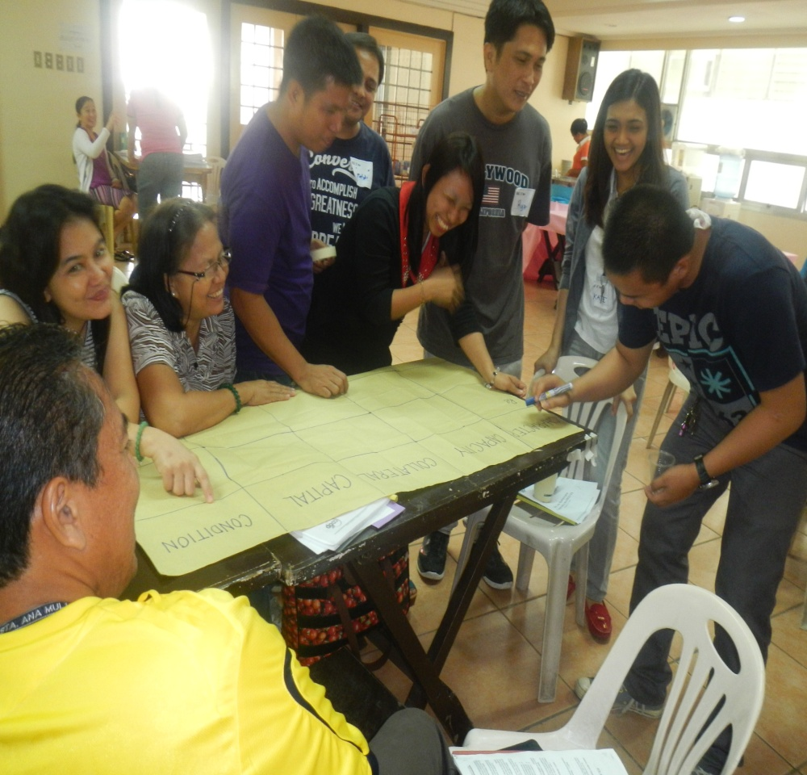
Professionalization Program for Credit Unions
Module 1: Organization and
Governance
Module 2: Financial Management
Module 3: Credit Management
Module 4: Human Resource
Management
Module 5: Strategic Planning

Slide 23
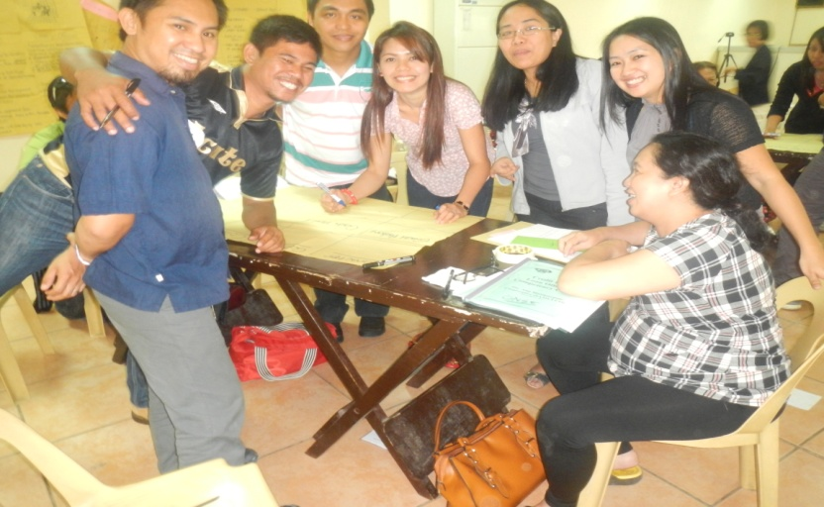
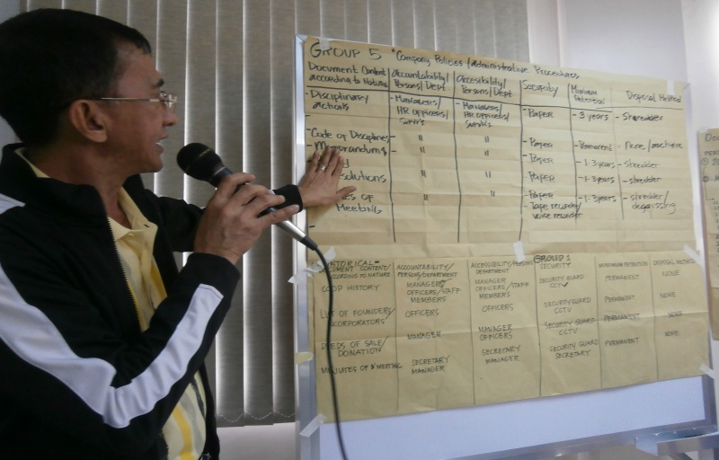
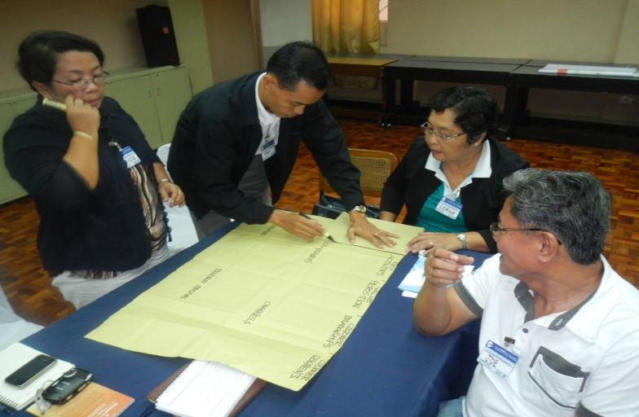
Leadership Development Program
Credit Union Directors’ Competency Course (CUDCC)

Slide 24
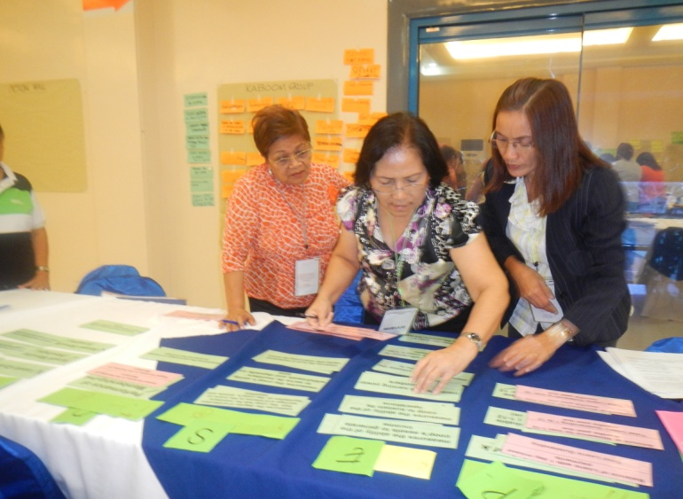
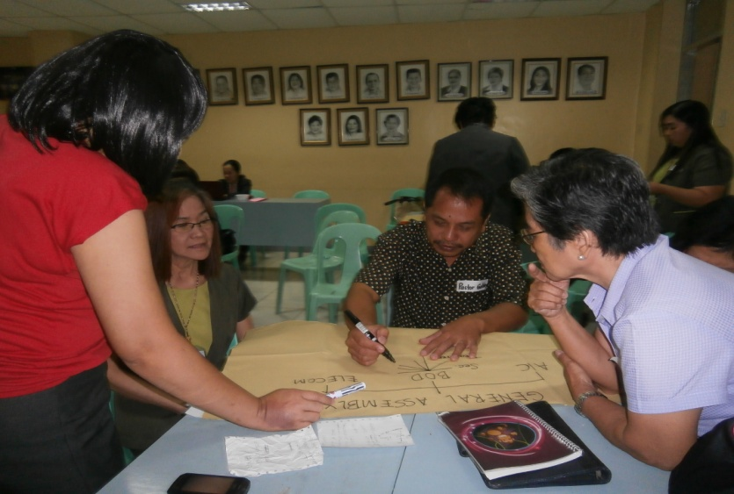
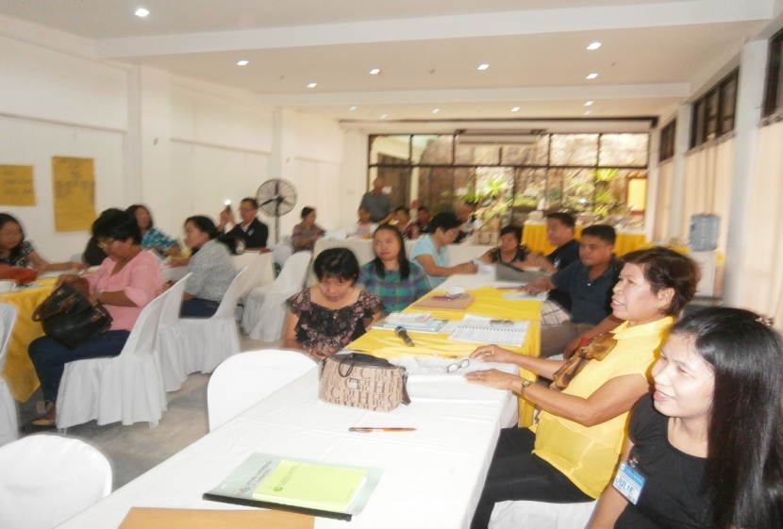
Management Development Program
Credit Union CEOs’ Competency Course (CUCCC)

Slide 25

Credit Union Solution No. 14
Governance Framework for Credit Unions
ASSOCIATION OF ASIAN CONFEDERATION
OF CREDIT UNIONS

Slide 26
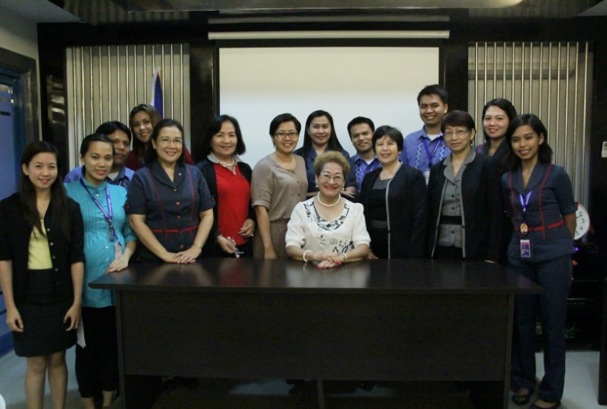
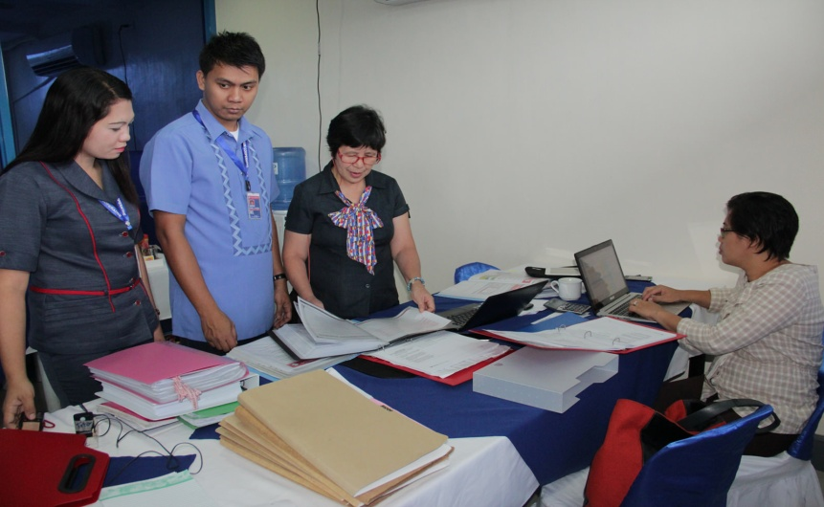
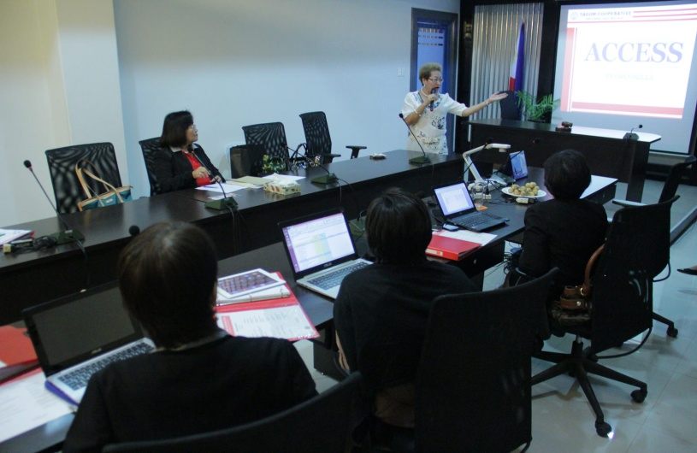
Branding Credit Unions in Asia
ACCESS
A-1 Competitive Choice for Excellent Service and Soundness

Slide 27
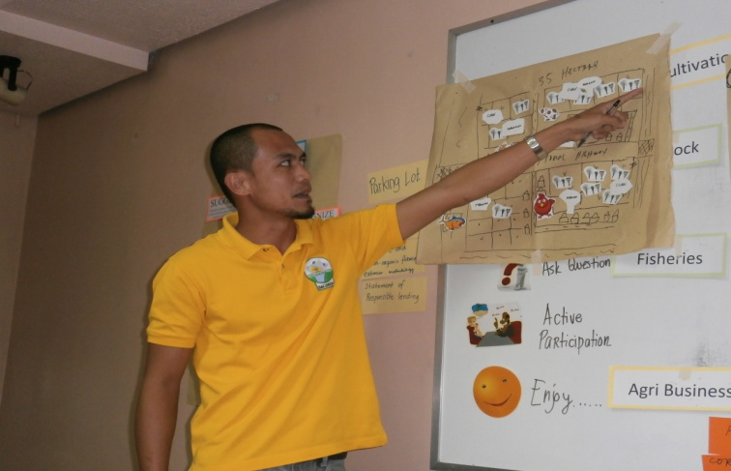
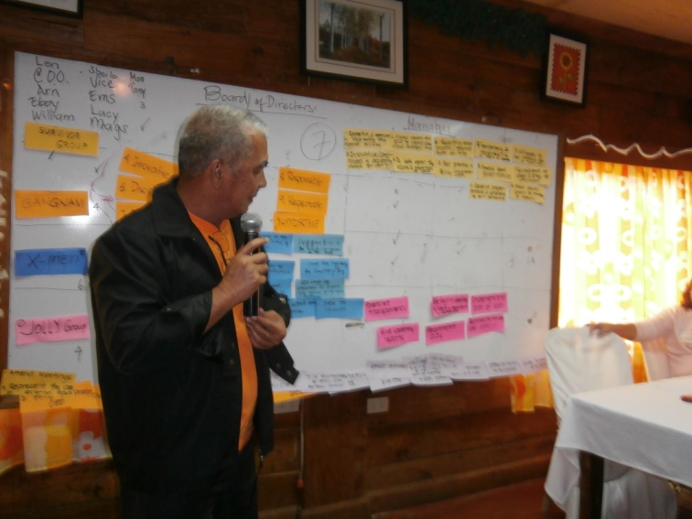
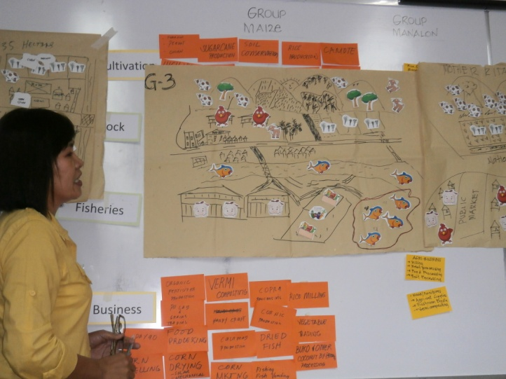
Membership Development
360 Degrees Financial Literacy for Credit Union Members

Slide 28
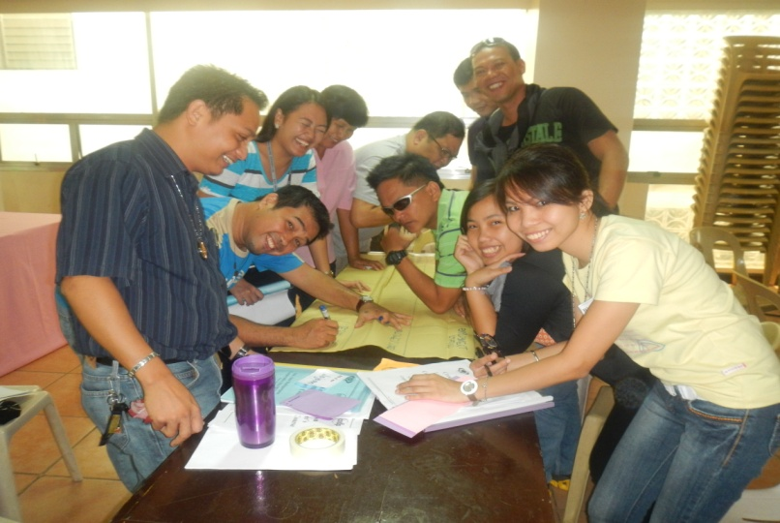
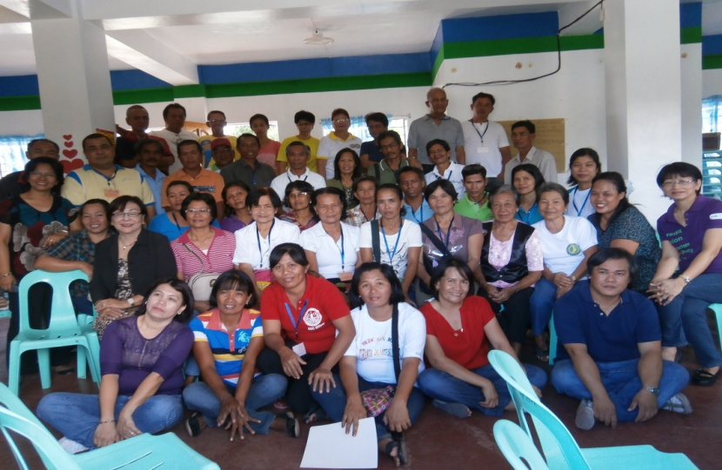
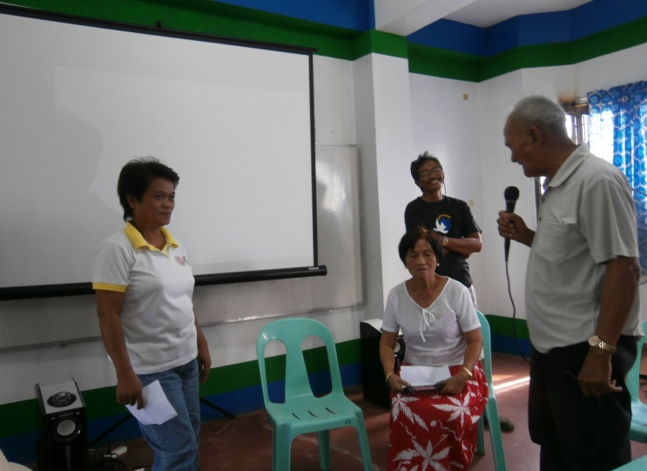
Staff Development
Loan Officers’ Competency Course

Slide 29
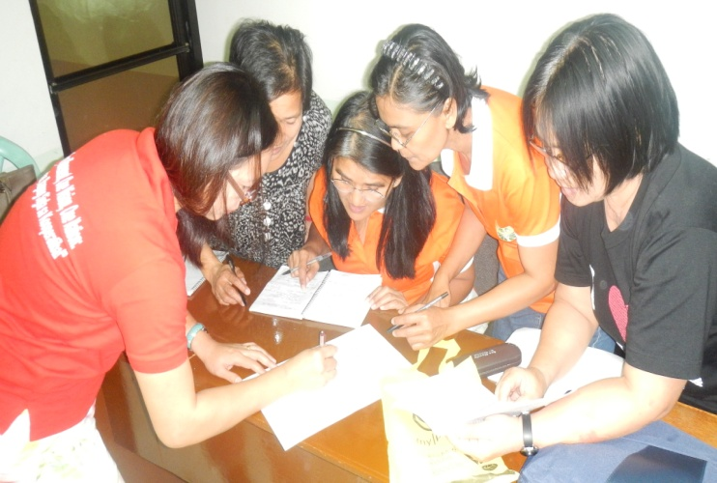
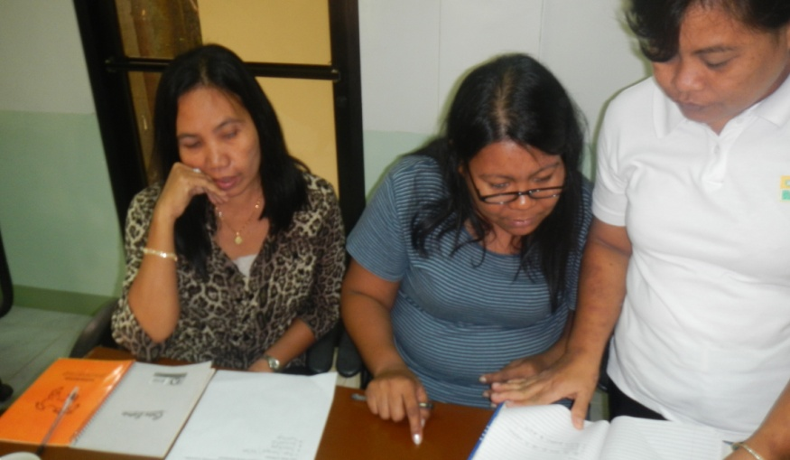
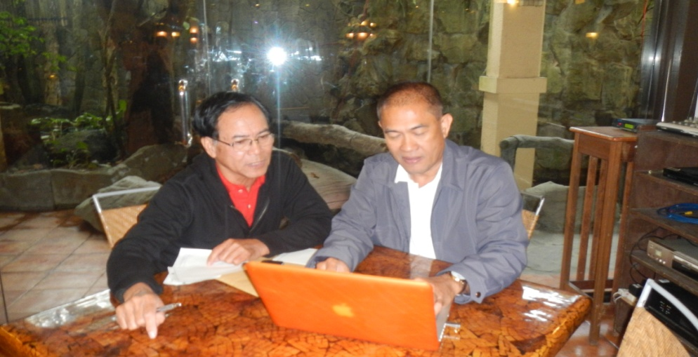
Officers’ Development
Audit Committee/Competency Course

Slide 30

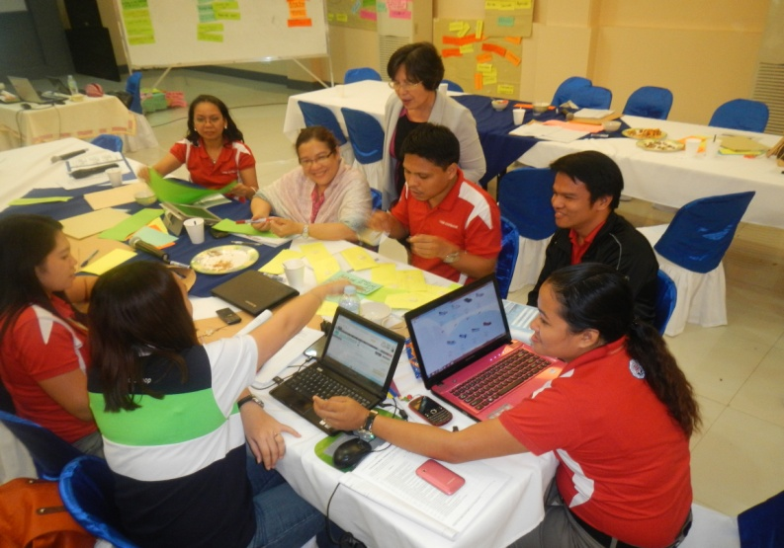
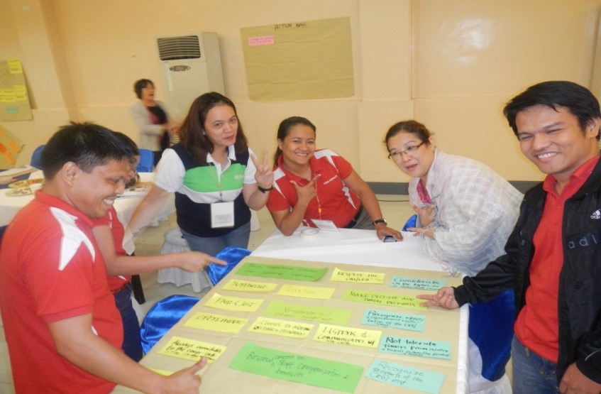
Officers’ Development
Risk Based Supervisory Tool

Slide 31
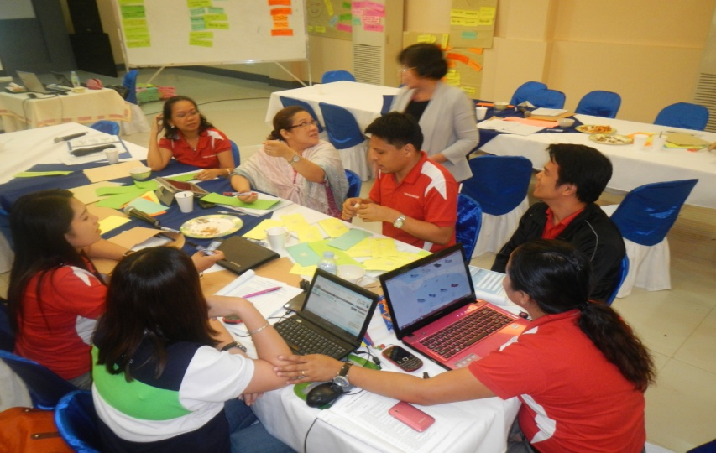
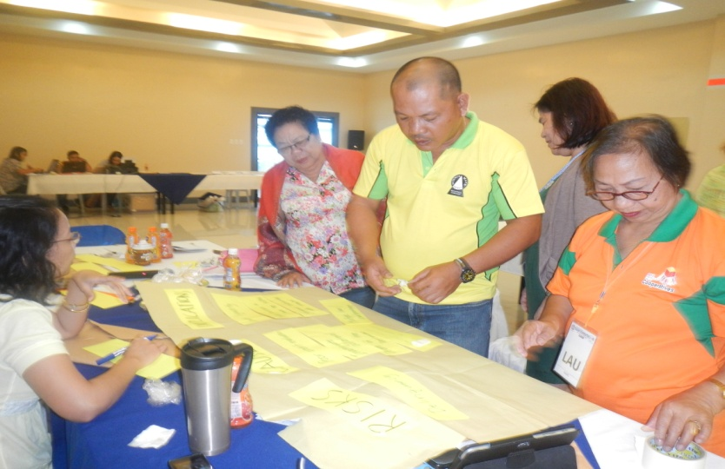
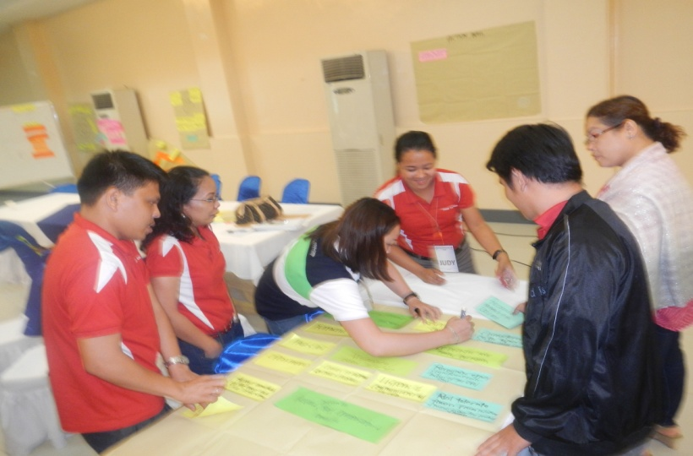
Others
Compliance Seminars for Board and Officers required by RA 9520

Slide 32
The Compliance Seminars
1. Basic Cooperative Course | 8. Audit Management
Cooperative Management and Governance | 9. Records Management
3. Financial Management | 10. Entrepreneurial & Business Management
4. Conflict Management | Basic Accounting for Non- Accountants
5. Parliamentary Procedure | 12. Internal Control
6. Leadership and Values Re-orientation | 13. Rules Formulation
7. Strategic Planning | 14. Cooperative Standards

Slide 33
Aflatoun Child Social and Financial Education
Children and Youth Development

