Slide 1
ICA-AP Committee on University/Campus Co-op
September 2014, Bali, Indonesia
University Co-operatives’ Activities of the Past Year
~Report from Japan~
National Federation of University Co-operative Associations
Executive Director Shinichi Maita
Notes:
1

Slide 2
Financial Data in 2013
Turnover: 187 billion yen (+0.8% compared to the previous year)
Bookstore: 34.9 billion yen (year-on-year decrease of 1.6%)
General store: 74.9 billion yen (year-on-year increase of 0.6%)
Services: 47.8 billion yen (year-on-year increase of 1.7%)
Dining hall: 29.4 billion yen (year-on-year increase of 2.8%)
Current surplus: 530 million yen (year-on-year increase of 24.5%)
Number of customers: 100 million 6,900 people (year-on-year increase of 0.8%)
Number of co-op members: 1.54 million people (year-on-year decrease of 27,000 people)
Number of new members: 240,000 people (year-on-year increase of 1.2%)

Slide 3
Trends in Turnover and Current Surplus
In 2011, the turnover decreased to 184.4 billion yen due to Great East Japan Disaster. In 2013 the number increased 0.8%.
We are on track to recovery after the Bankruptcy of Lehman Brothers. In 2013, we have an increase turnover and surplus for the first time after several years.

Slide 4
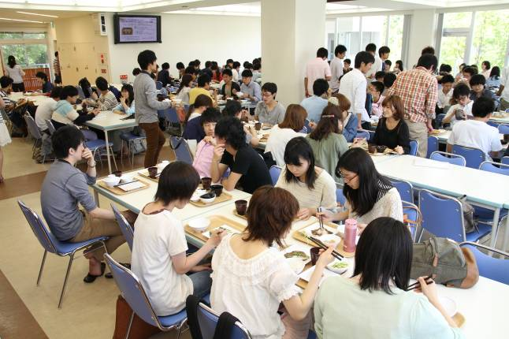
New Facilities (Osaka University Co-op)
Along with the earthquake resistance construction of the 4-storey Welfare and Health Building, Osaka University Co-op fully refurbished the dining hall and store.

Slide 5
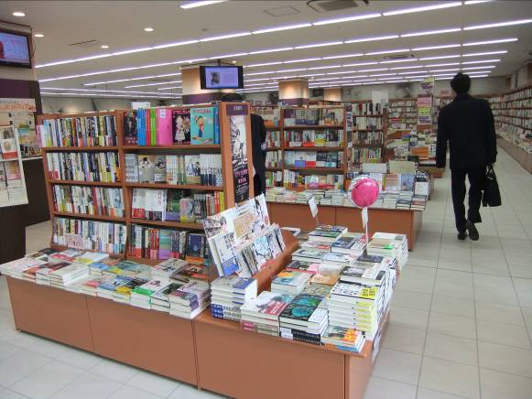
New Facilities (Doshisha University Co-op)
Doshisha University Co-op moved to a new facility that consists of dining hall, store and service center. This is a larger facility to cope with the increasing number of students in Imadegawa Campus.

Slide 6
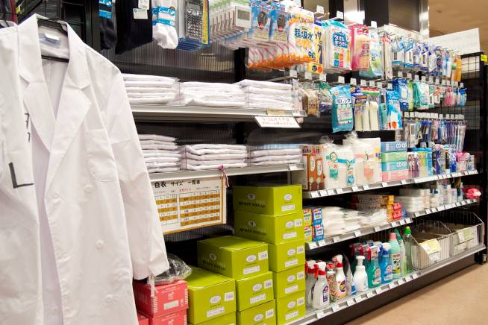
New Facilities (Keio University Co-op)
Keio University Co-op took over the business rights of dining hall and store in Shiba Kyoritsu Campus that were operated by other company, conducted overhaul, then reopened its operation.

Slide 7
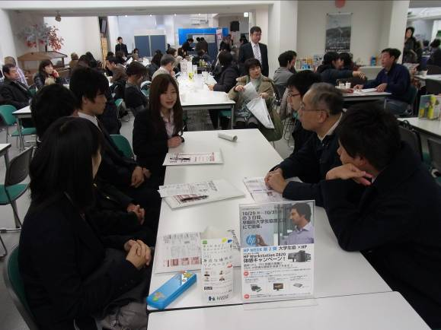
Events to Welcome New Students
Senior students provide consultation about college life to new students and their parents. (Picture: Waseda University Co-op)

Slide 8
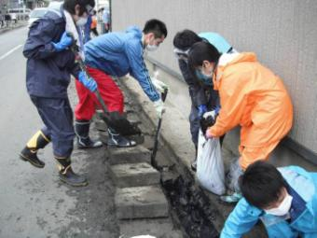
Earthquake Reconstruction & Rehabilitation Assistance (Fourth year - Continuing)
To date, we have dispatched more than 1000 students from 130 universities as volunteers for earthquake reconstruction & rehabilitation assistance program.

Slide 9
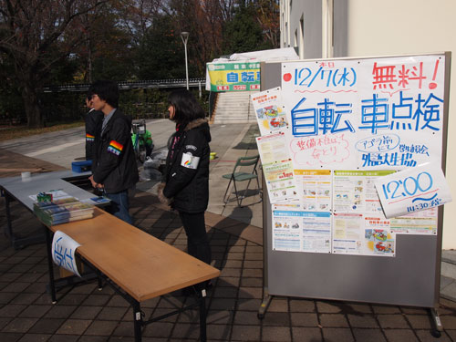
Student Mutual Benefit
Number of policyholders: 659,000. Benefits paid in 2013: 3.26 billion yen.
We also conduct a wide range of preventive education, such as diet consultation and bicycle accident prevention program. (Picture: Free bicycle inspection at Tokyo University of Foreign Studies Co-op)

Slide 10
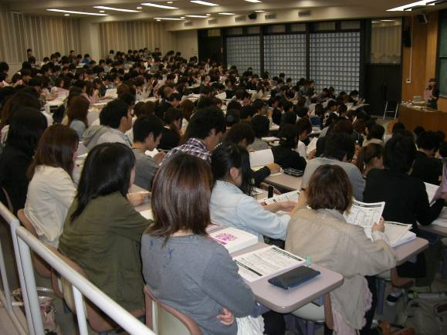
Activities to Support Learning and Growth of Students
We conduct various activities to support learning and growth of students.
(Picture: Guidance on Public Servant Examination Course in Kanazawa University Co-op)

Slide 11
Current Issues (from Our BoD during the past year)
Increased investment of university co-ops
Self-financing as required by the university
Intensifying market competition
Convenience stores, electronic commerce companies (Amazon, etc.), vending machine installation bid, insurance companies, etc.
Reviewing the possibility of creating the national organization of business association
We are reviewing the consolidation of 9 business associations in Japan
We want to strengthen each business association and efficiency of national organization
E-books and electronic materials
How to contribute to the education innovation using e-books and electronic materials, and demonstrating the raison d'être (existence value of university co-ops)

