Slide 1


WORKING OF CAMPUS CO-OPERATIVE IN MALAYSIA
CO-OPERATIVE COLLEGE OF MALAYSIA

Slide 2
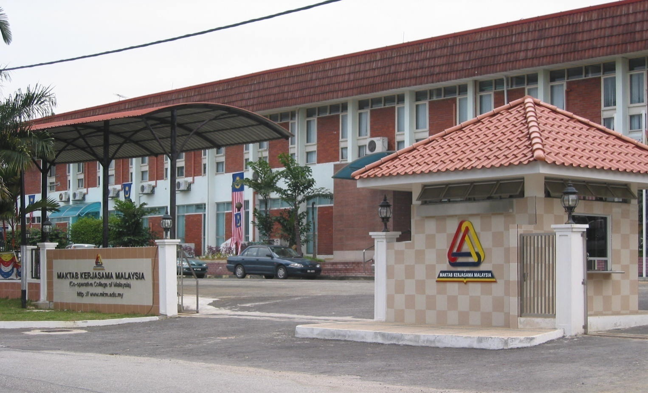
ICA-AP

Slide 3
ESTABLISHMENT
13 November 1956
Finance from Colonial Welfare and Development Fund
Incorporated as a statutory body in 1968
Agency under Ministry
ICA-AP

Slide 4

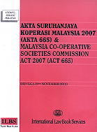
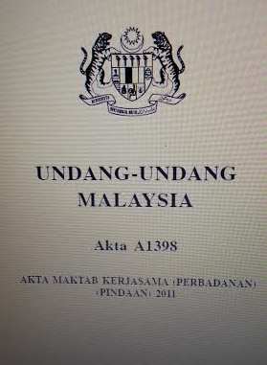
MINISTRY OF DOMESTIC TRADE, CO-OPERATIVE & CONSUMERISM (MDTCC)
MALAYSIA
CO-OPERATIVE SOCIETIES COMMISSION
CO-OPERATIVE COLLEGE
OF
MALAYSIA
Registrar
Regulatory
Training
ICA-AP

Slide 5
FUNCTION
Organizing co-operative-related courses;
Printing and publishing of books on co-operative and matters related to them;
Conducting research and provide consultancy services.
ICA-AP

Slide 6
VISION
To be a world-class co-operative education institution
ICA-AP

Slide 7
MISSION
To be a centre of excellence for the enhancement of human capital in the co-operative movement through innovative, effective and customer focused training, education and knowledge based services imbued with co-operative values and principles
ICA-AP

Slide 8
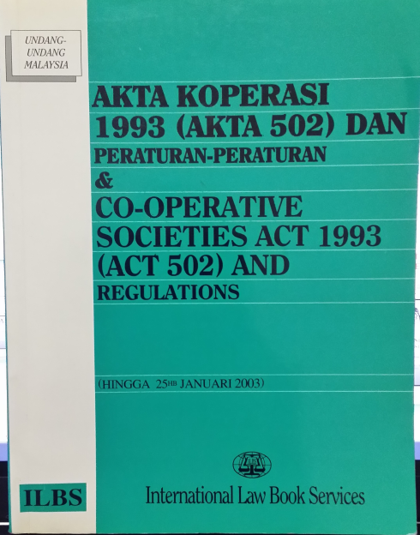
FINANCING
OPERATING BUDGET
DEVELOPMENT BUDGET
Government (Treasury)
Co-operative Act of 1993 mandates contribution of 2% of net profits of co-operative to the fund
ICA-AP

Slide 9
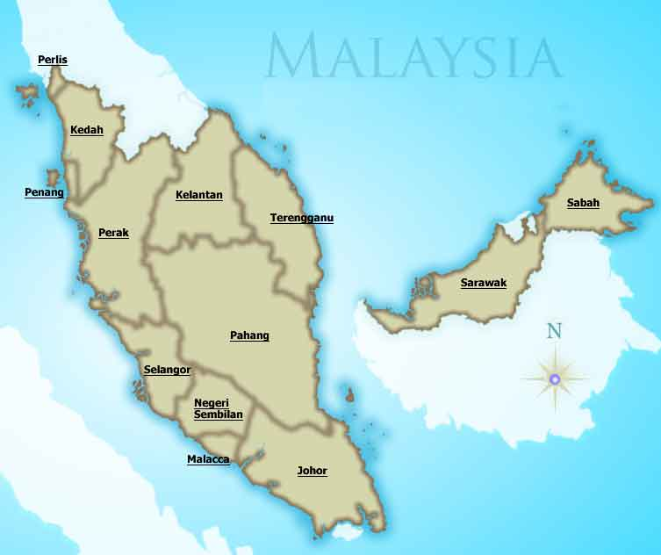
CAMPUSES
Main Campus : PETALING JAYA, SELANGOR ( 1956)
Branch Campuses : KOTA KINABALU ,SABAH (1997)
: KUCHING, SARAWAK (1998)
: JOHOR BAHRU, Johor (2009)
: BERA , PAHANG (2009)
: ALOR SETAR , KEDAH (2010)
ICA-AP

Slide 10
CAMPUSES
BRANCH CAMPUSES
ALOR SETAR
KEDAH (2010)
BRANCH CAMPUSES
BERA
PAHANG (2009)
BRANCH CAMPUSES
KOTA KINABALU SABAH (1997)
BRANCH CAMPUSES
KUCHING SARAWAK (1998)
MAIN CAMPUS PETALING JAYA (1956)
BRANCH CAMPUSES
JOHOR BAHRU, ]Johor (2009)
ICA-AP

Slide 11
ORGANIZATION STURCTURE
COUNCIL MEMBERS
DIRECTOR GENERAL
ACADEMIC
ADMINISTRATION
ICA-AP

Slide 12
TARGET PARTICIPANTS
Board Members, Internal Auditors
Employee of Co-operatives
Members of Co-operatives
Government Officers supervising Co-operatives
Individuals (public and private sectors)
ICA-AP

Slide 13
ACADEMIC CENTRES
Higher Education
Business
Accounting & Finance
Co-operative Governance, Law & Leadership
Information Technology & Communication
Co-operative Consultancy
Research Management & Innovation
International & Corporate Communication
ICA-AP

Slide 14
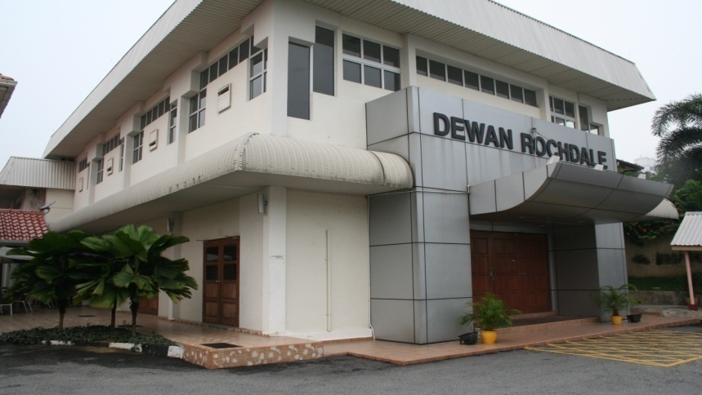
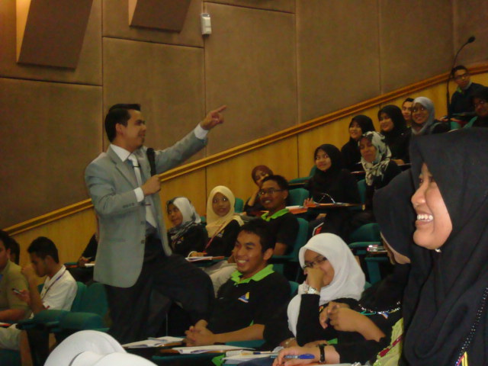
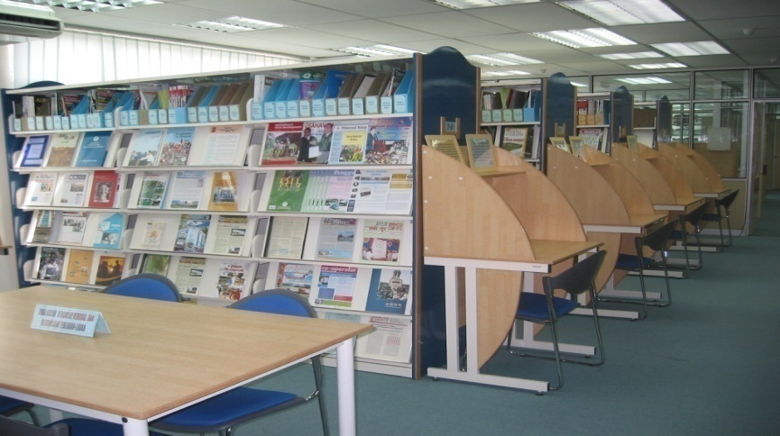
PHYSICAL FACILITIES (main campus)
Training Rooms
Library with more than 80,000 books
Hostel accommodation for 300 participants
Auditorium
Multipurpose hall
Indoor and outdoor sport facilities
Cyber (IT Lab)
Cafeteria
ICA-AP

Slide 15
TRAINING PROGRAMMES
Short duration courses (3 days – 2 weeks)
Long Term Courses (6 months and above)
Degree in Business Administration (majoring in Co-operative Management) (MKM-UUM) – Full time
Diploma in Co-operative Management
Diploma Professional in Co-operative Auditing (MKM-ICMA) – ePJJ
Certificate in Co-operative Management
-
ICA-AP

Slide 16
MALAYSIAN TECHNICAL COOPERATION PROGRAMME (MTCP)
Certificate in Co-operative Management
Certificate in Co-operative Auditing
Certificate in Human Resource Management
Certificate in Desktop Publishing (IT)
Certificate in Co-operative Poverty Reduction
ICA-AP

Slide 17
CONSULTATION SERVICES
Co-operative Auditing
Finance Management
Retail Management
Strategic Management
Training Methodology
ICA-AP

Slide 18
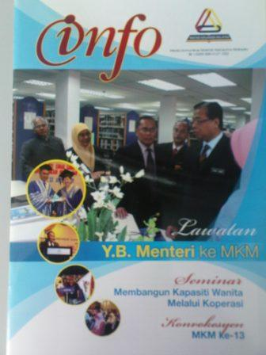

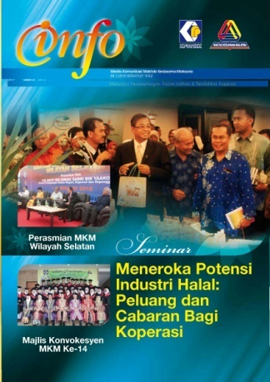

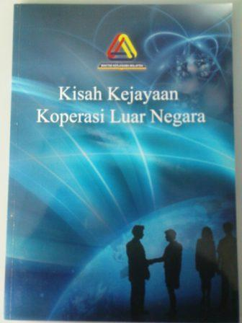
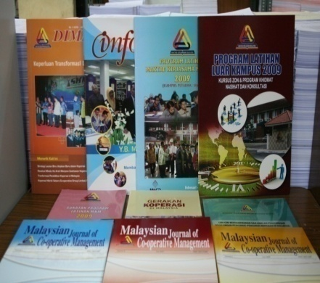

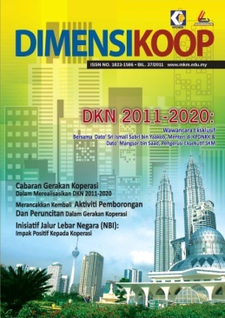
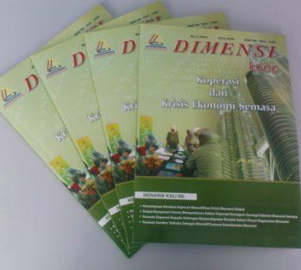
PUBLICATION
Dimensi
Info MKM
Management Series
Monograph
Journal
CD
(e-learning)
ICA-AP

Slide 19
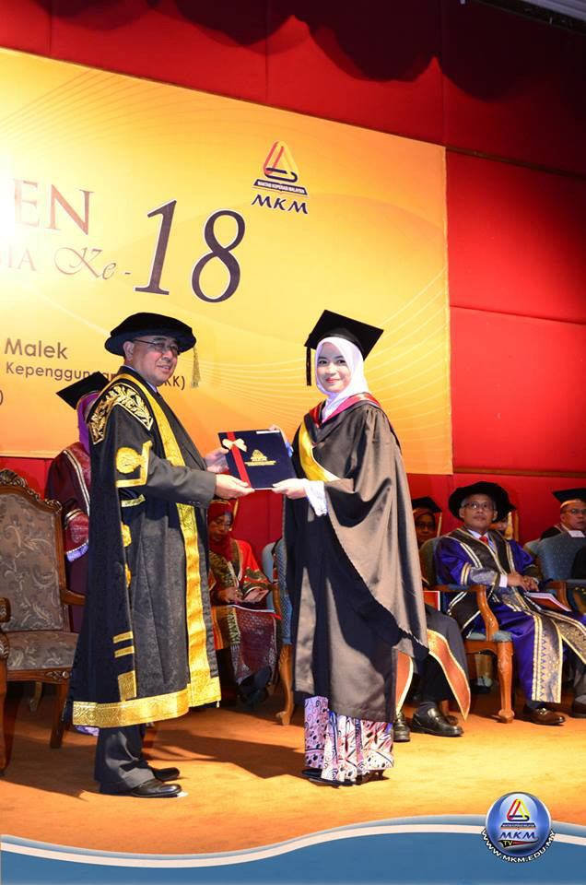
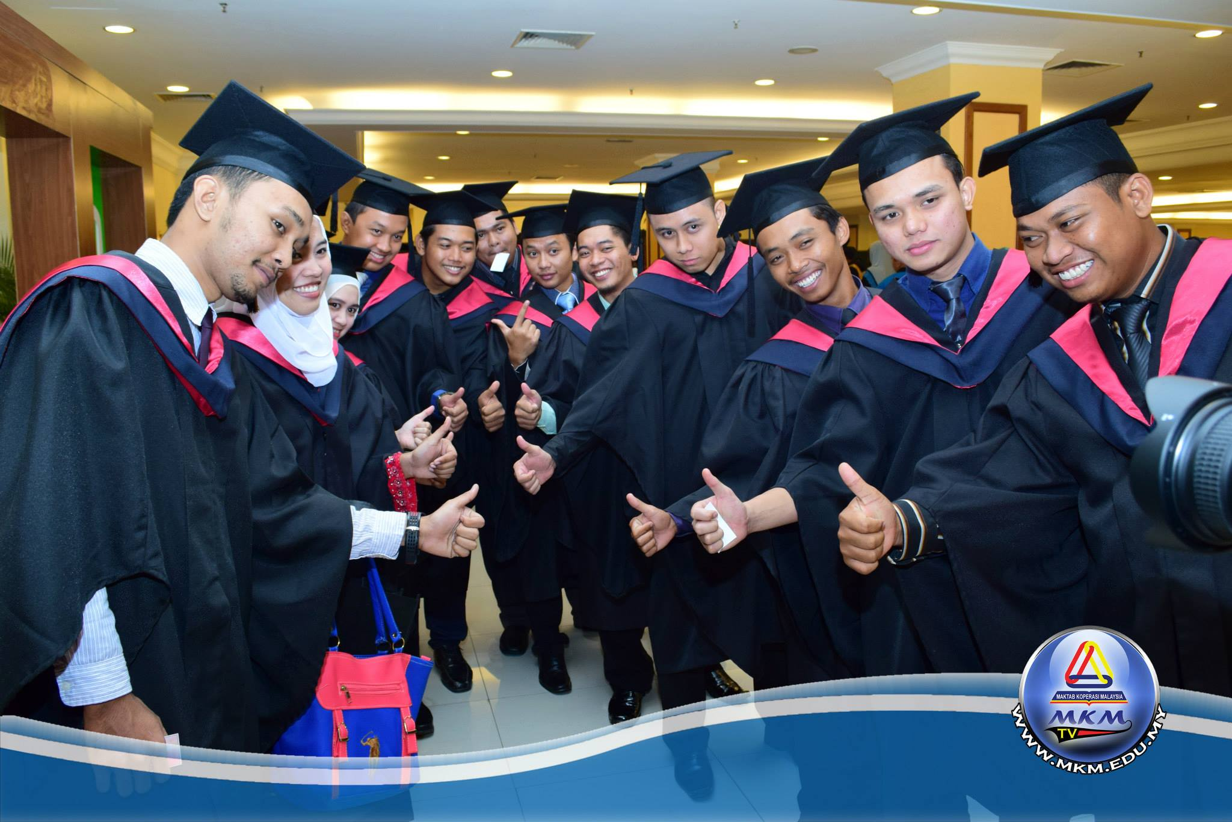
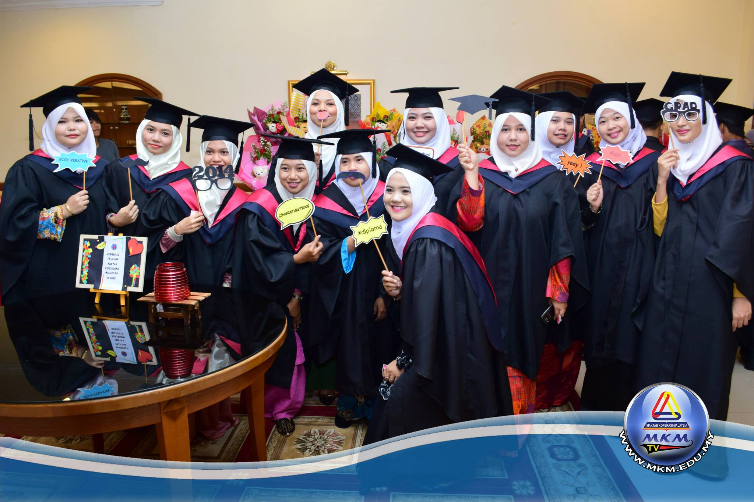
CONVOCATION
ICA-AP

Slide 20
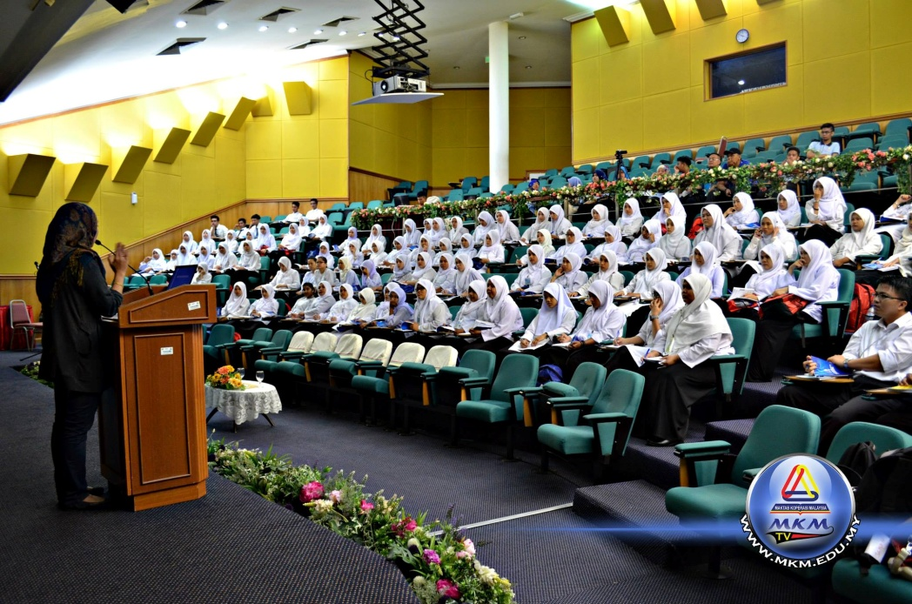
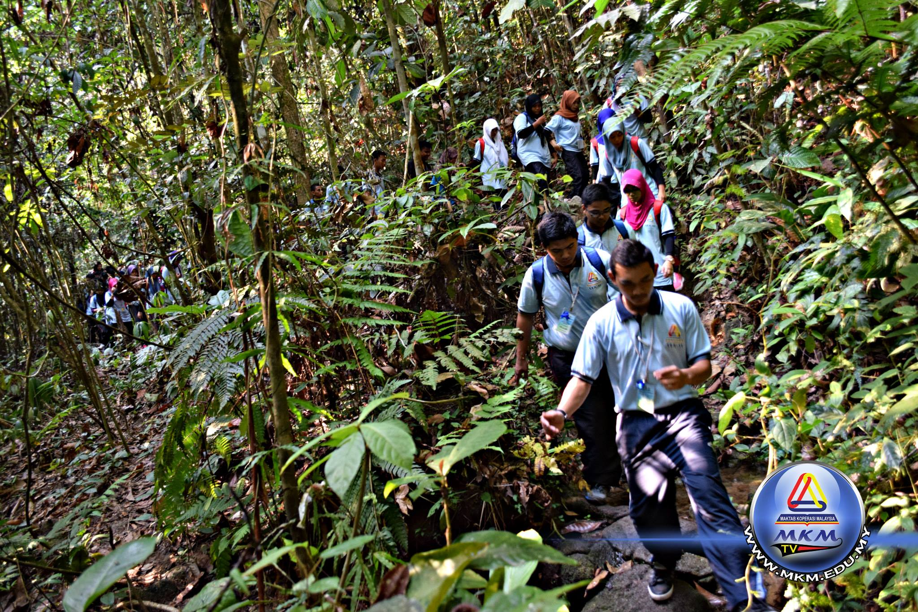
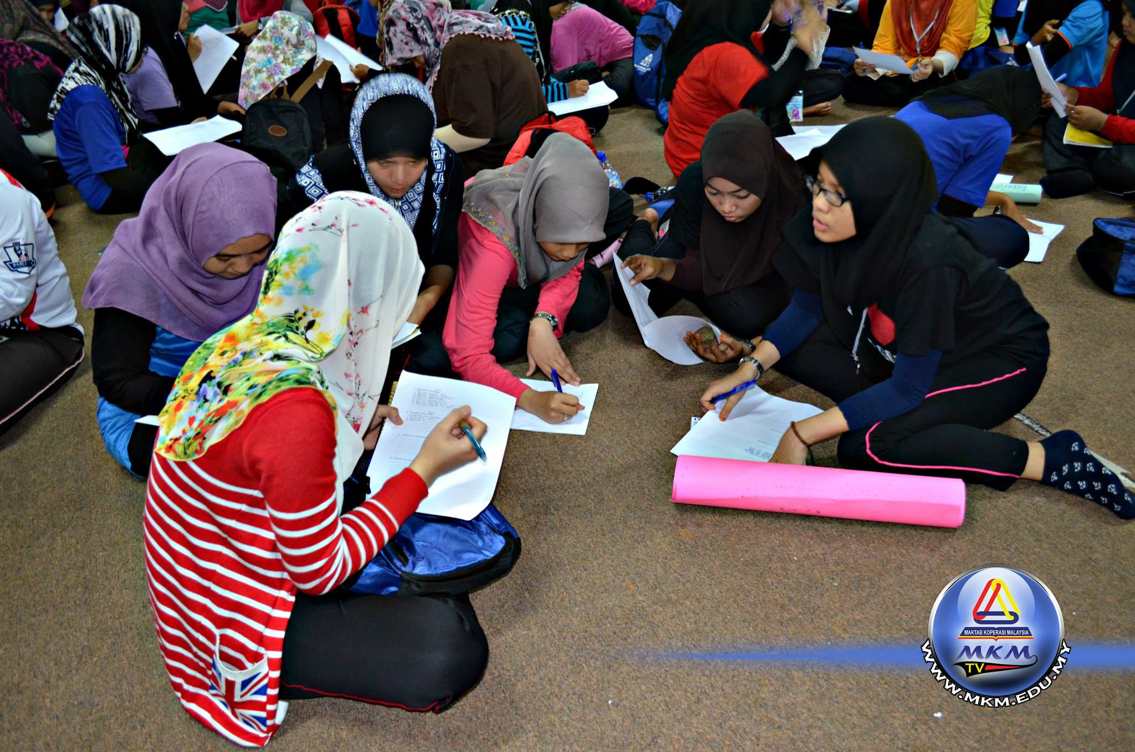
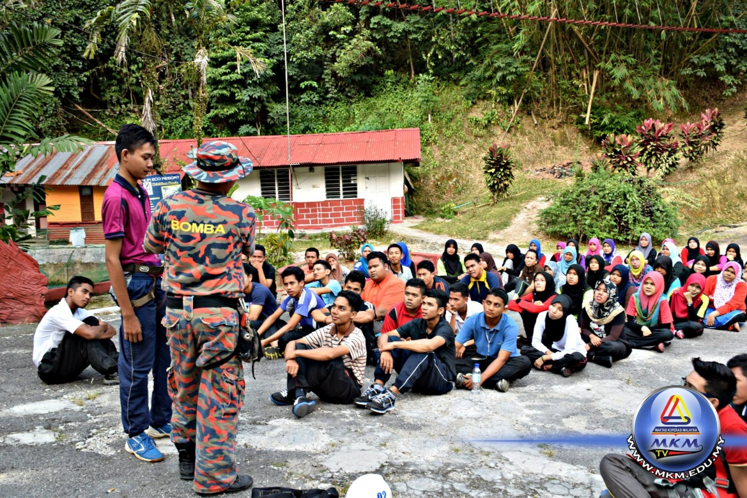
ORIENTATION WEEK
ICA-AP

Slide 21
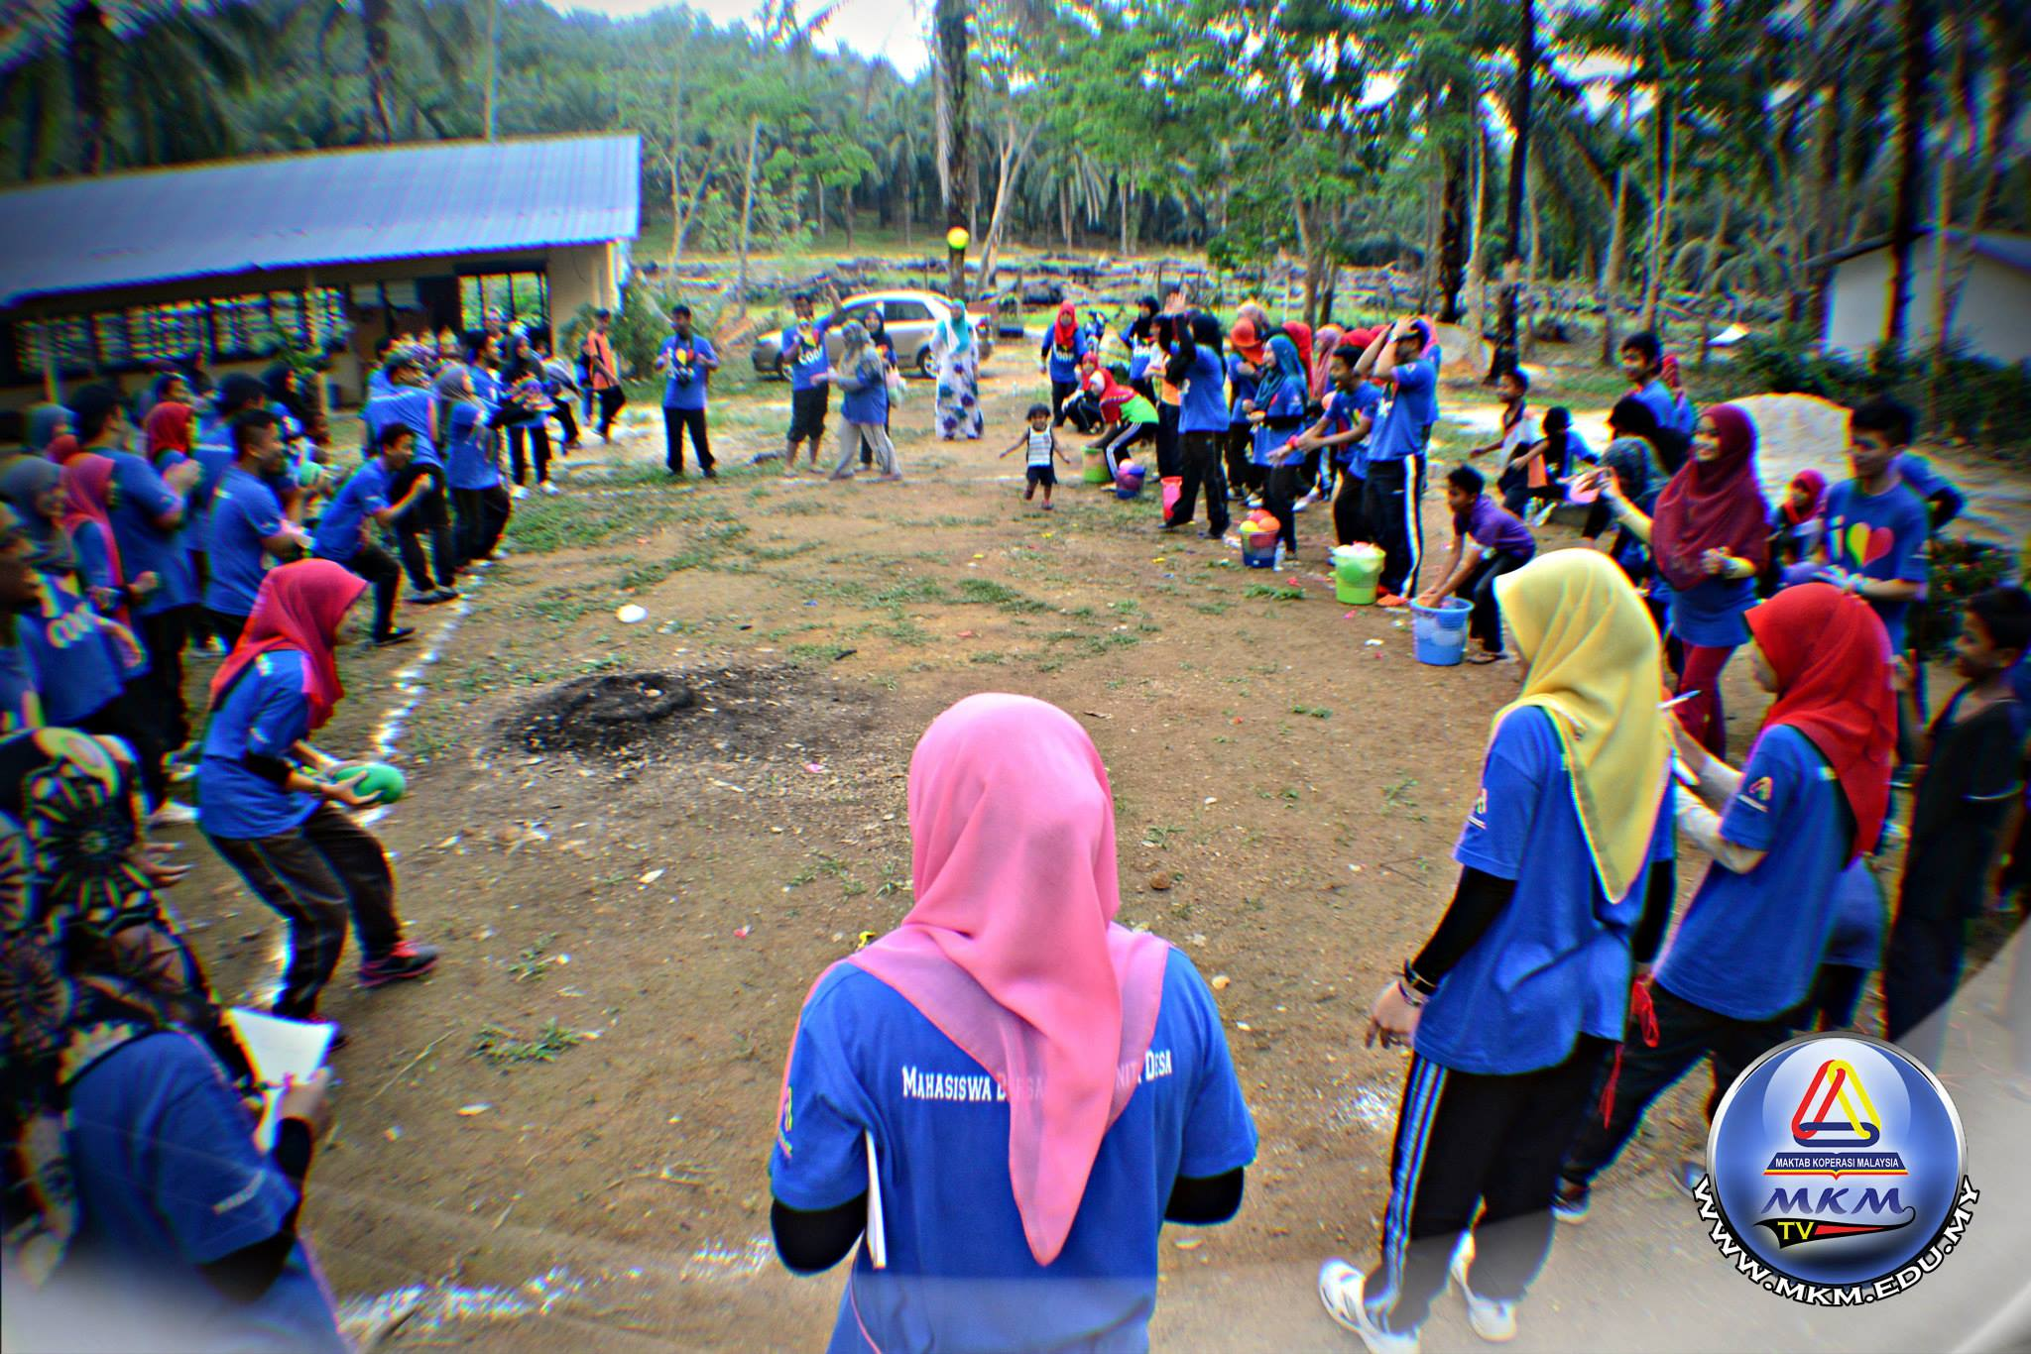
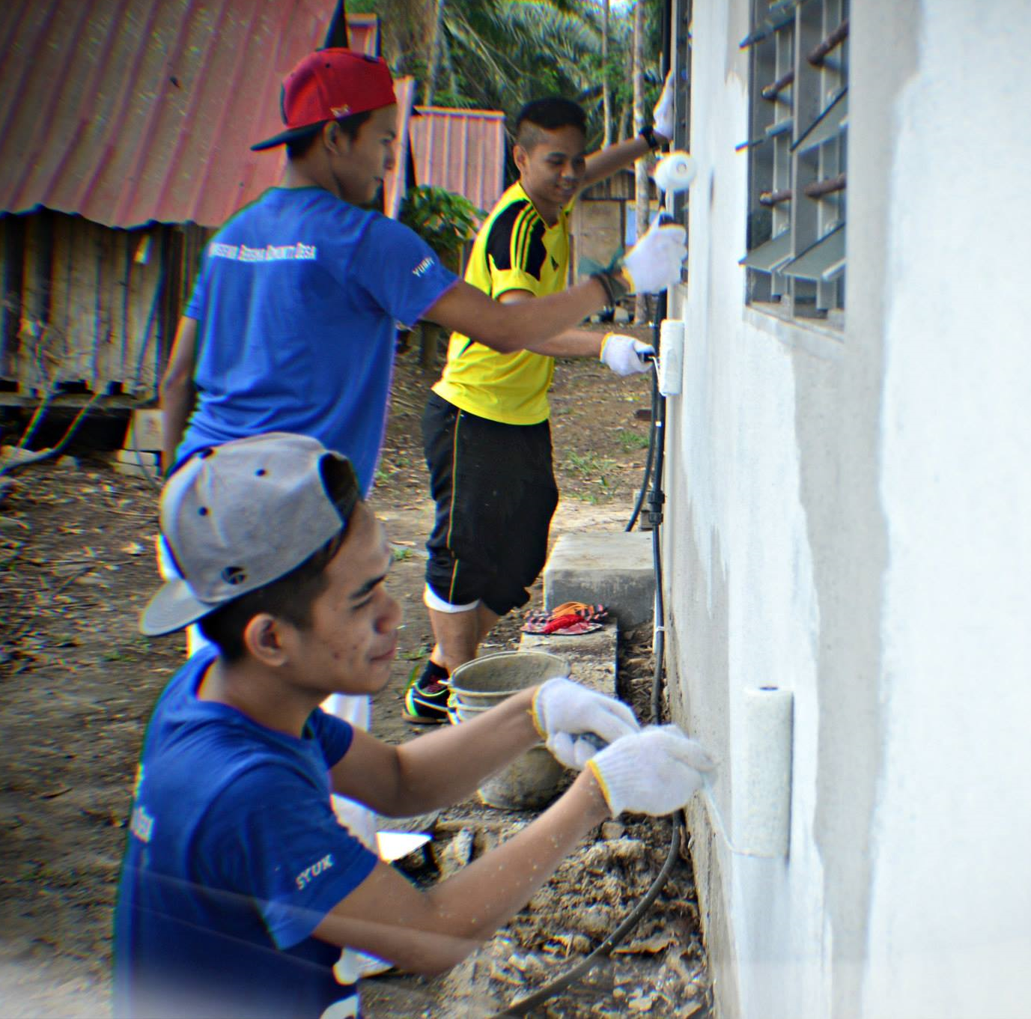
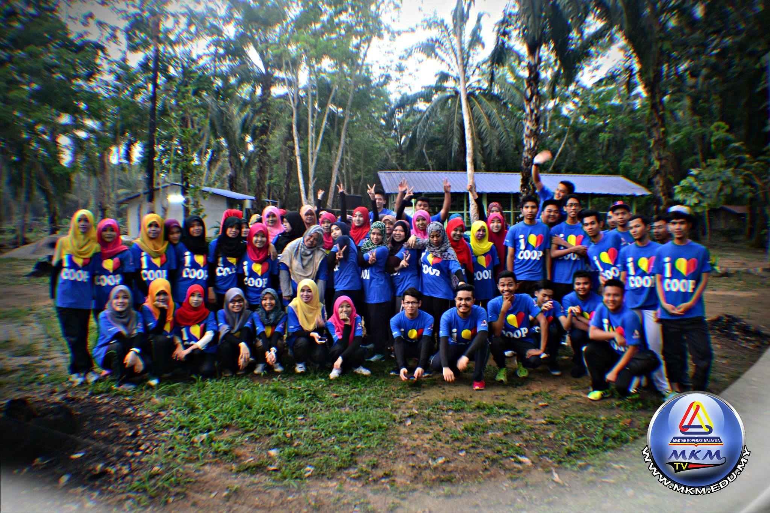
CSR
ICA-AP

Slide 22
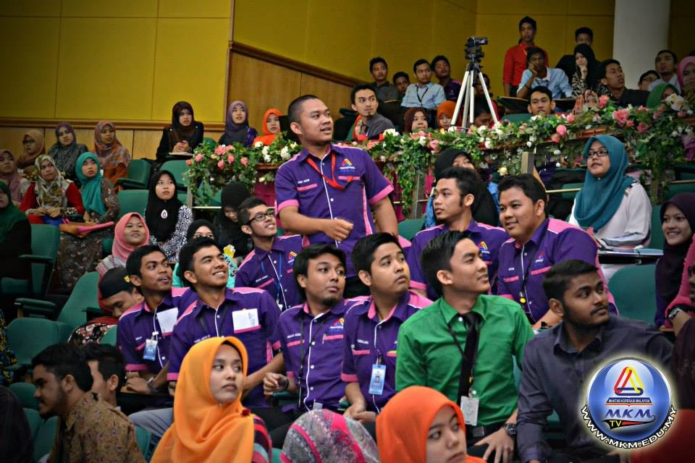
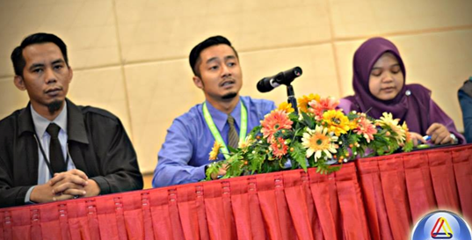
CO-OPERATIVE ANNUAL GENERAL MEETING
ICA-AP

Slide 23
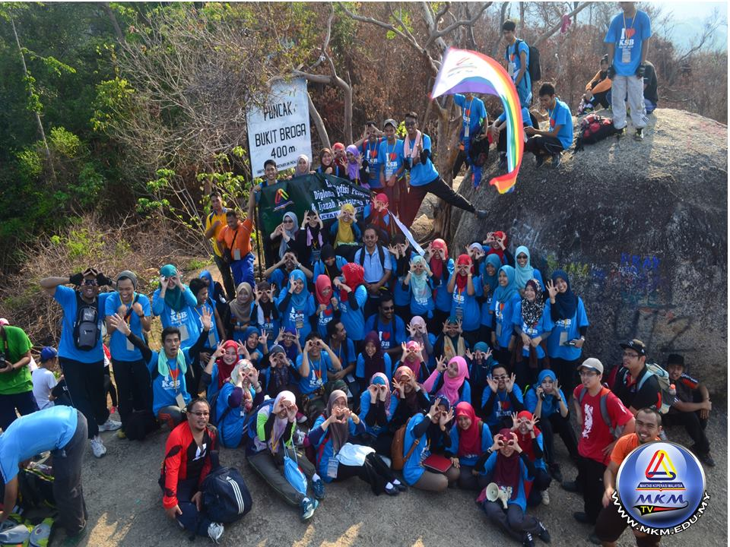
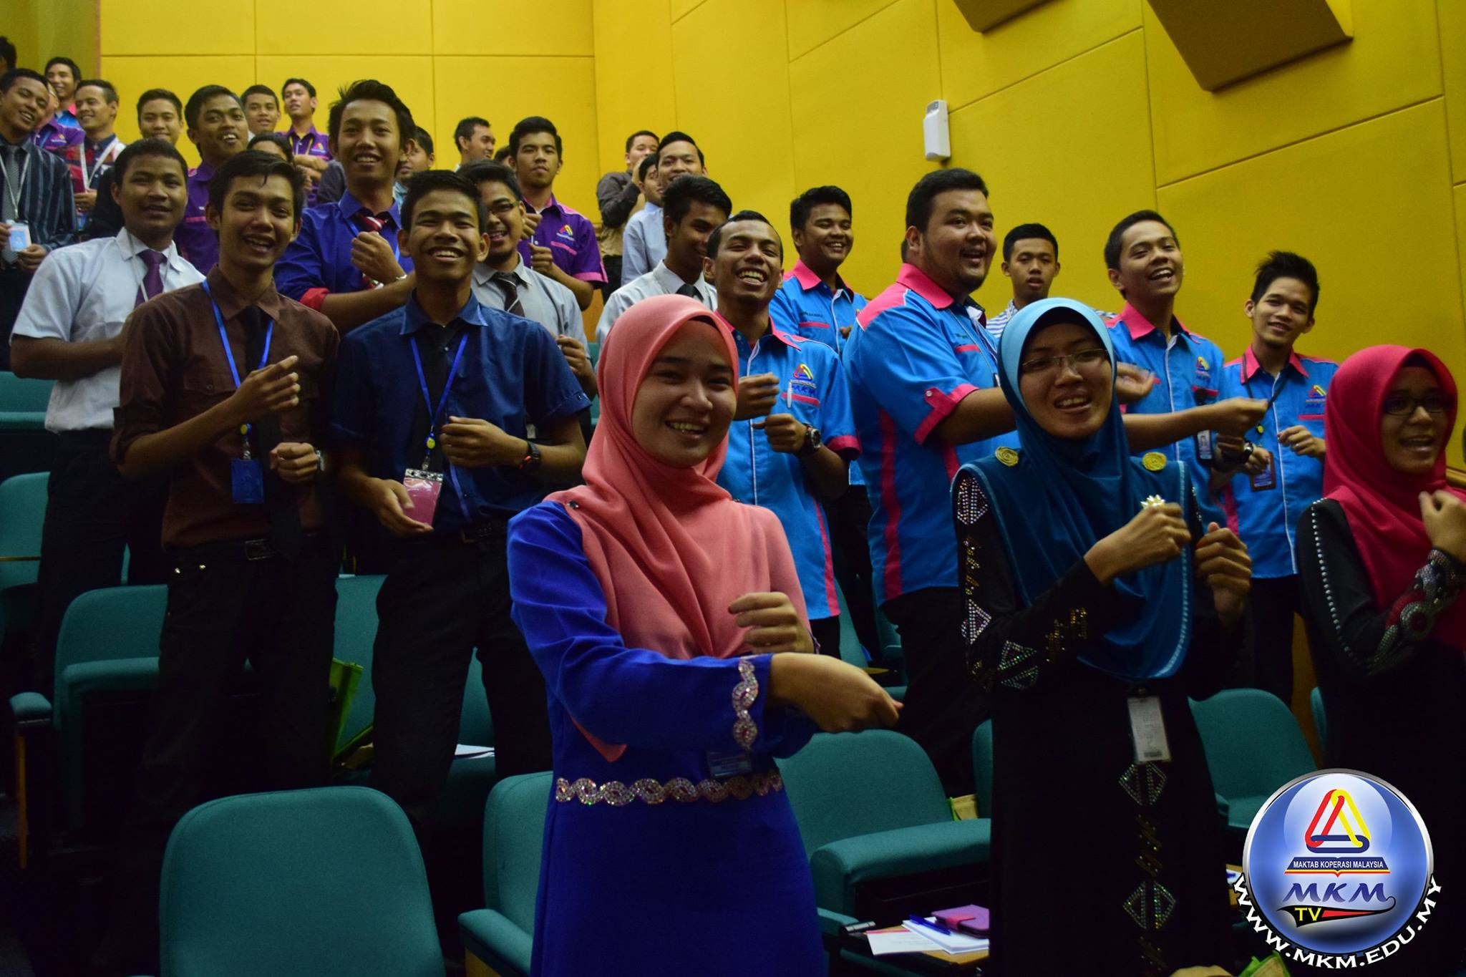
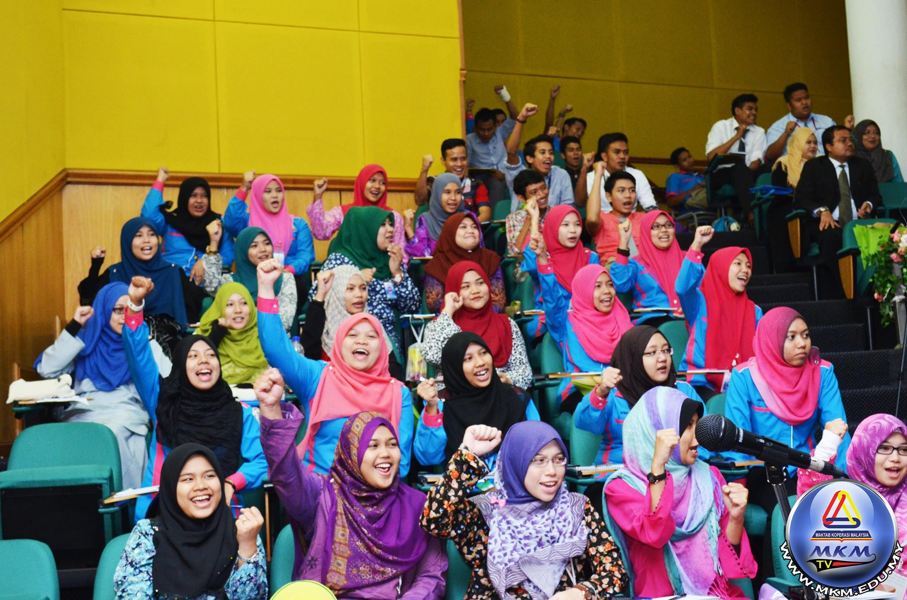

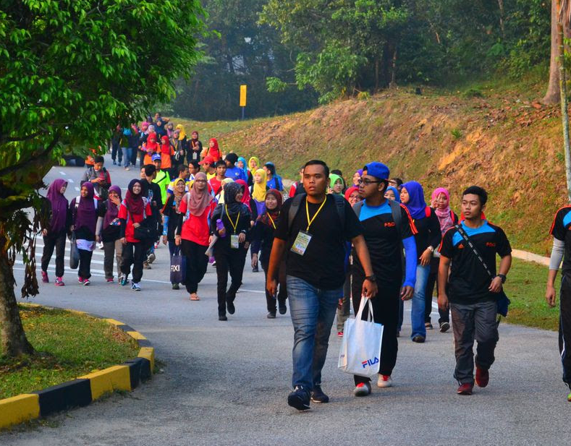
OTHER ACTIVITIES
ICA-AP

Slide 24


THANK YOU
ICA-AP

